Slide 1

Devon Rural Affairs Update
FOLLOW US ON TWITTER: @DCPoliceRural_D

Slide 2

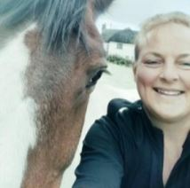
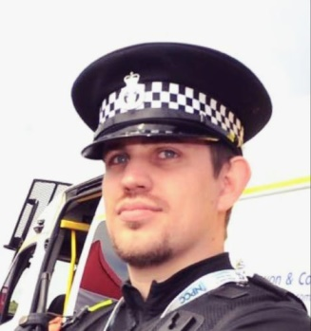
WHO WE ARE & WHAT WE DO
DEVON
Our Role – To act as a focal point for partner agencies, driving activity to ensure the NPCC National Rural Affairs strategy priorities are delivered in Devon and Cornwall.
What do Rural Affairs Officers do?
  Build best practice within the service including training and toolkits
  Improve the way the service collates intelligence and raise emerging issues
  Co-ordinate the service's response to rural crime with our strategic partners
  Improve the service's working relationship with partner agencies and businesses
PC Martin BECK
PC Kerry WHITTING
SC Adam BUSH
FOLLOW US ON TWITTER: @DCPoliceRural_D

Slide 3
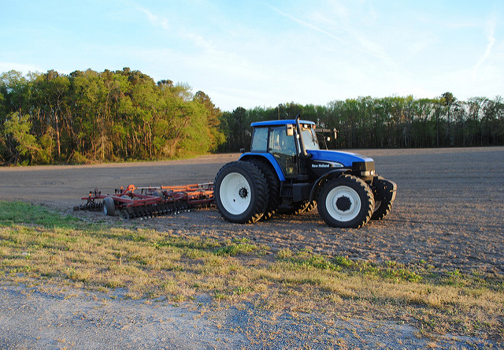
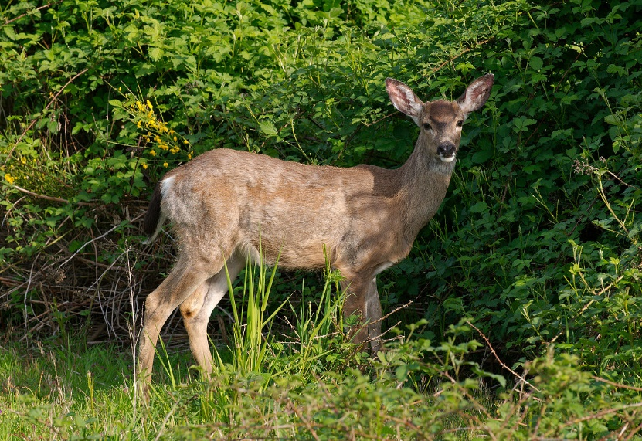
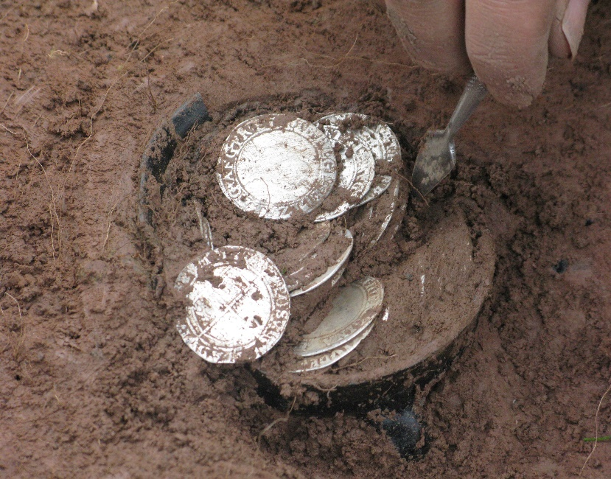
RURAL AFFAIRS PRIORITIES
Rural Affairs
  Farm Machinery, Plant & Vehicle Theft
  Livestock Offences
  Fuel/Battery Theft
  Equine Crime
  Fly Tipping
  *Poaching
Wildlife Crime
  Badger Persecution
  Bat Persecution
  Raptor Persecution
  CITES
  Freshwater Pearl Mussels
  Cyber-Enabled Wildlife Crime
  *Poaching
Heritage & Cultural Property Crime
  Criminal Damage to Sites/Buildings
  Theft from Heritage Sites/Buildings
  Theft of Heritage/Cultural Assets
FOLLOW US ON TWITTER: @DCPoliceRural_D

Slide 4
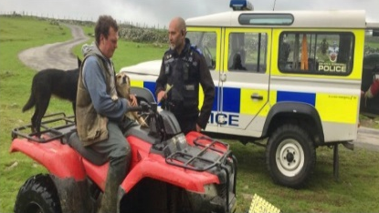
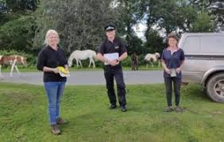
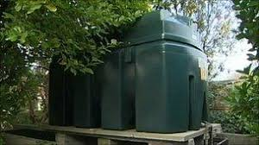
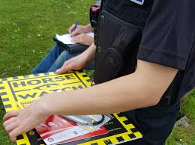
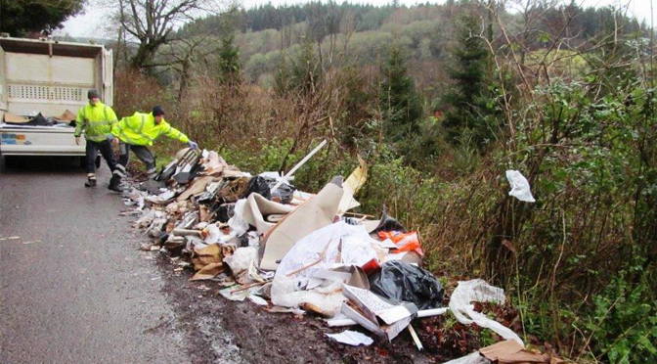

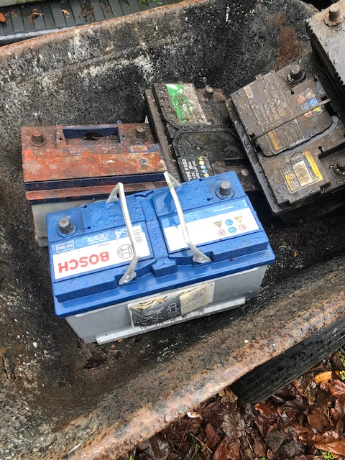
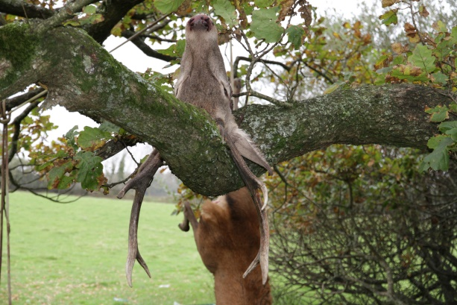
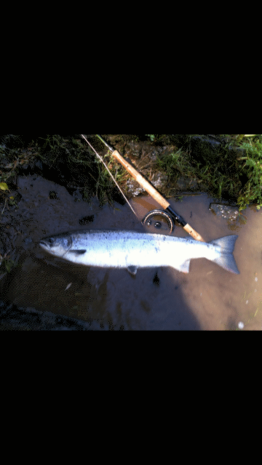
RURAL CRIME UPDATE
  Farm Machinery, Plant & Vehicle Theft
  Livestock Offences
  Fuel/Battery Theft
  Equine Crime
  Fly Tipping
  Poaching
FOLLOW US ON TWITTER: @DCPoliceRural_D

Slide 5
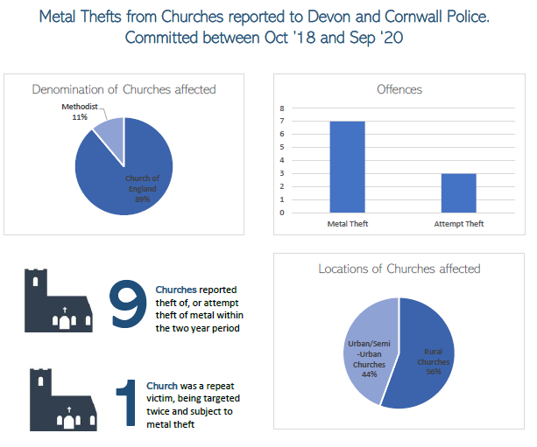
ECCLESIASTICAL CRIME 2020
46
Churches reported theft, burglary or criminal damage to police in 2020 (including attempt theft/burglary)
6
Churches were repeat victims of crime. Only 1 church was recorded as a victim more than twice in 2020
FOLLOW US ON TWITTER: @DCPoliceRural_D

Slide 6
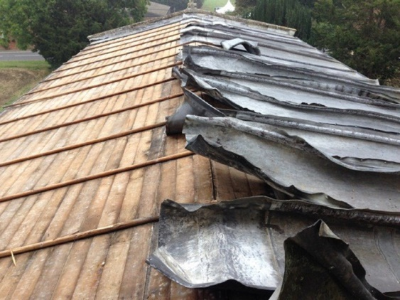
OP CRUCIBLE – WHAT IS IT?
Op Crucible is the name given to the multi-agency response to metal theft from historic buildings, including many churches. This includes periods of disruption activities, engagement with the scrap metal industry, crime prevention advice and intelligence sharing and co-ordination.
“The value of England’s heritage cannot be judged in pounds and pence. The impact of theft on our historic sites and buildings has far-reaching consequences over and above the financial cost of what has been stolen. Heritage crime comes in many forms. When thieves steal metal from protected sites and buildings such as churches, they are stealing from all of us and damaging something which is often irreplaceable. By working together with law enforcement agencies, we are maximising our ability to identify those who are attacking our shared cultural heritage.”
Mark Harrison, National Policing and Crime Adviser – Historic England
FOLLOW US ON TWITTER: @DCPoliceRural_D

Slide 7
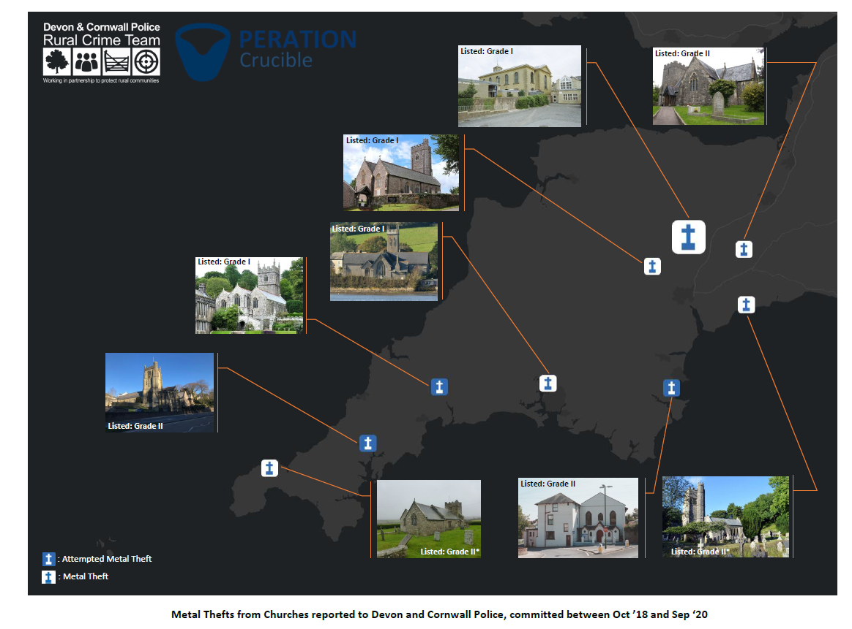
OP CRUCIBLE – OFFENCES
FOLLOW US ON TWITTER: @DCPoliceRural_D

Slide 8
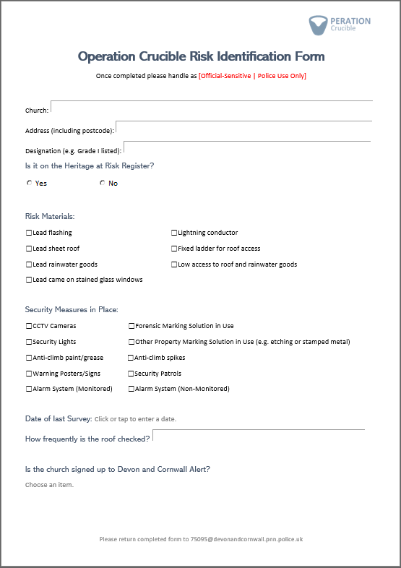
OP CRUCIBLE – WHAT WE ASK
It would assist the team with identifying churches which are at particular risk of heritage crime if each could complete the Op Crucible Risk Identification form. Completing it may also assist in the development of your own risk assessment and suitable preventative measures to consider.
During a heritage and cultural property crime conference it was highlighted that some Ecclesiastical insurance companies are not requiring a crime reference when processing claims. We would ask that even though the insurance companies may not require it, that any metal theft from churches is reported to the police so that we have an accurate picture of this offence type.
FOLLOW US ON TWITTER: @DCPoliceRural_D

Slide 9
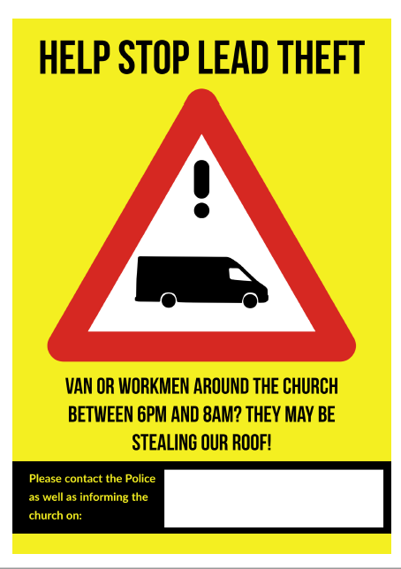
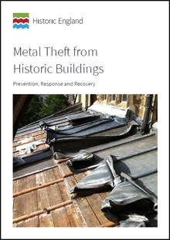
CRIME PREVENTION
You can find out more by reading the
Historic England advice note,
Metal Theft from Historic Buildings.
Visit: www.HistoricEngland.org.uk
and search ‘Metal Theft’.
If your church has leaded roof, guttering etc. consider displaying the Help Stop Lead Theft poster on the church notice board. Not only will this encourage the congregation and community to be vigilant, but may also act as a deterrent to would-be criminals. A pdf copy of this poster is available from the Rural Affairs Officers
FOLLOW US ON TWITTER: @DCPoliceRural_D

Slide 10
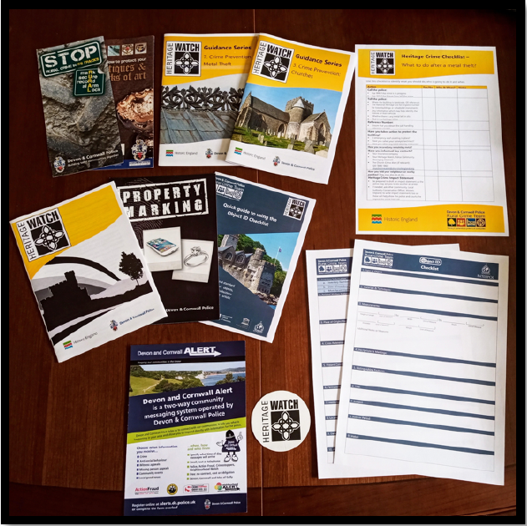
HERITAGE WATCH
Heritage Watch schemes enable the public to report and share information on crime, suspicious behaviour and damage they observe at heritage assets in their community or while out and about.
Historic England is working with police services around the country to introduce more Heritage Watch schemes, including here.
Coming Soon
FOLLOW US ON TWITTER: @DCPoliceRural_D

