Slide 1
Graham Biggs MBE
Rural Services Network
Revitalising Rural

Slide 2
Rural Services Network

Slide 3
House of Lords Select Committee on the Rural Economy
https://parliamentlive.tv/event/index/c2535866-cc39-40bb-bbd2-a06a94729468?in=16:53:29&out=16:55:32
Lord Foster

Slide 4
The Government responded…
Over the coming months, the government will expand on its strategic vision and set out how, working across departments and working with stakeholders, it is putting in place a range of measures to ensure that rural areas continue to thrive.

Slide 5
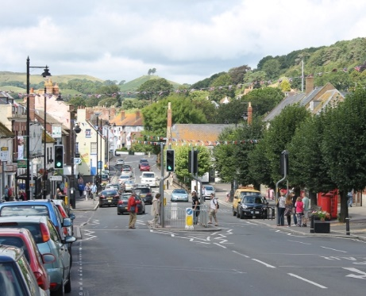
…but not all rural communities are thriving still
Urban areas still receive some 61% per head in Settlement Funding Assessment grant more than rural counterparts
The average house purchase price is £90,000 higher in rural areas than it is in urban (excl London)
Business turnover per employee is lower in rural areas than it is in urban areas
Earnings (mainly from wages) for jobs which are based in rural areas are lower than for jobs based in urban areas
It is not possible to get an indoor 4G connection on all four networks at a majority (58%) of rural premises

Slide 6
We want a fairer distribution of national resources to rural areas and for more nuanced national policies that reflect rural circumstances.

Slide 7
Revitalising Rural
Rural Fair Funding
Rural Digital Connectivity
Rural Transport & Access to Services
Access to Rural Health and Care Services
Rural Further Education, Training & Skills
Rural Schools and Community Facilities
Rural Economies
Rural Planning
Parish Councils & Rural Community Action
Rural Town Centres & High Streets
Availability of Rural Affordable Housing
Managing an older rural population
Sustainable Farming and Land Management
14 intertwined policy areas
Decarbonising Rural Communities

Slide 8
Every Chapter contains...

Slide 9
Launch Event with Parliamentarians and decision makers

Slide 10
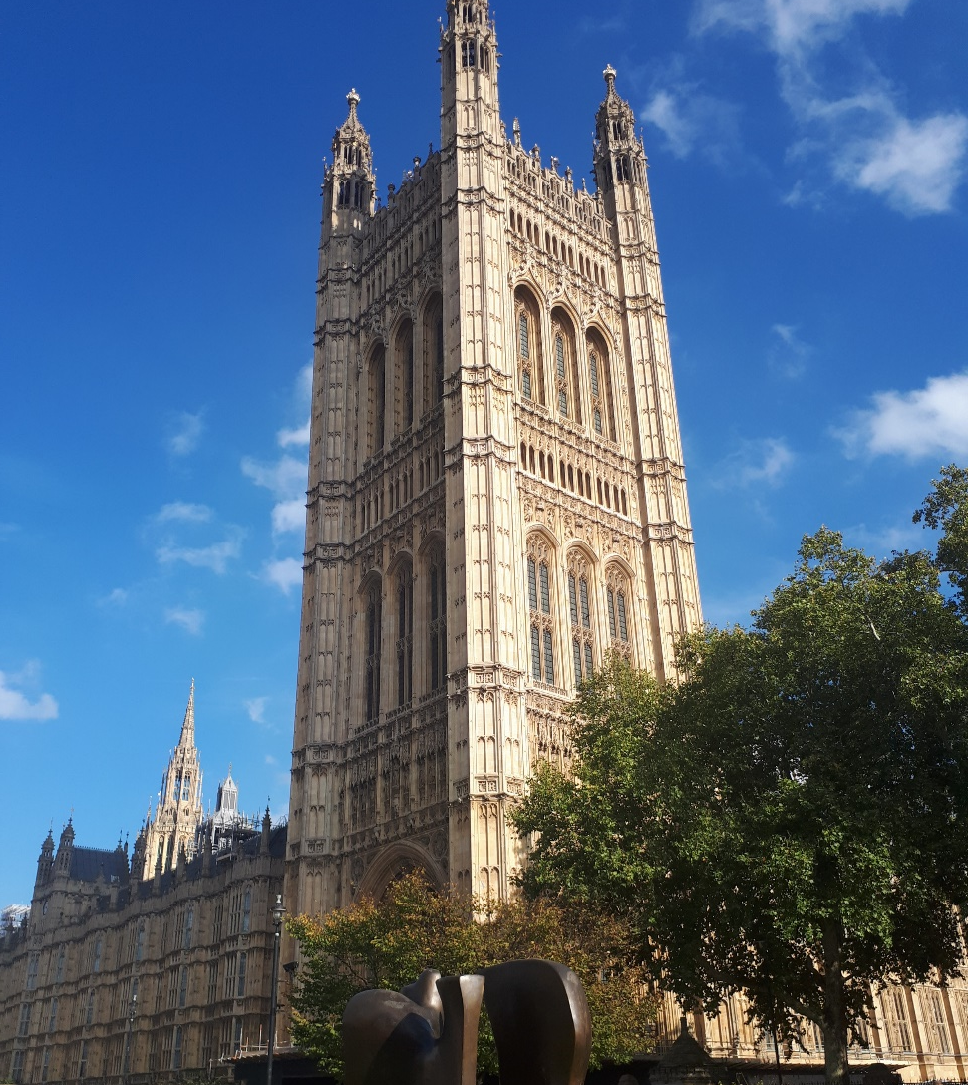
RSN working to raise the profile of Revitalising Rural
Rural Response to Government Consultations
Meeting with DCMS
Dedicated session with Membership on Hard to Reach areas
Constantly looking for opportunities to influence policy development

Slide 11
All information on the campaign is available at: www.rsnonline.org.uk/revitalising-rural

