Slide 1
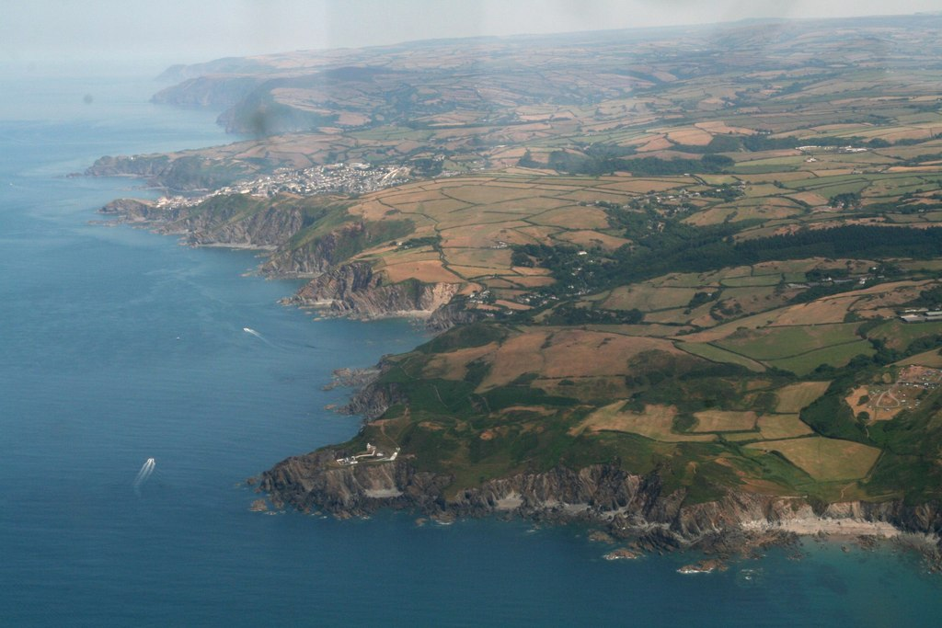
Tackling Rural Health Inequalities: Nora Corkery, CEO Devon Communities Together www.devoncommunities.org.uk

Slide 2
Devon Health Inequalities Gaps
Notes:
community buildings; community resilience; rural housing; enterprise; neighbourhood/community plans, sport and play; health and wellbeing and much more

Slide 3
Rural Health Inequalities Challenges in Devon
No rural area is the same - a mix of isolated coastal communities, remote rural communities and isolated dwellings and communities on the fringes of urban areas – all have different access to infrastructure and different needs
The Indices of Multiple Deprivation (IMD) fails to identify rural areas which may benefit from a different approach to the delivery of local health & care services.
Greater variability of deprivation in our geographically large rural areas means that pockets of high deprivation can be hidden.
The “rural premium” adds less than £4million to the CCG’s allocation which does not reflect the actual cost of maintaining the core health & care services in remote areas.

Slide 4
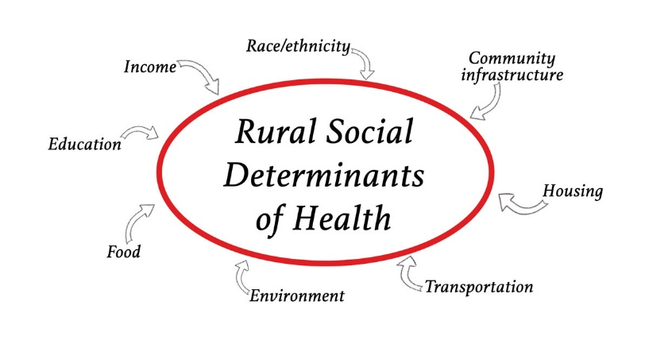
ACRE: Rural social determinants of health
Income levels are lower
Educational opportunities are harder to access
Rural occupations -more challenging workplace health and safety
Gender inequality - employment, low wages and limited childcare.
Food insecurity and lack of access to nutritious affordable food
Older housing stock, lack of affordable housing & fuel poverty
Less diverse childhood recreational and leisure opportunities, and higher rates of loneliness amongst young people
Availability of public transport has diminished, limiting life choices
Increased dependence on older vehicles - higher emission levels

Slide 5
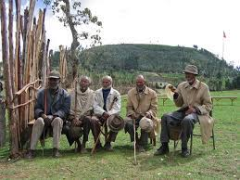
Working together to tackle rural health inequalities in Devon
Devon CCG/ICS & VCSE are already actively collaborating on tackling Health Inequalities in Devon.
DCT hosted an online seminar on Tackling Health Inequalities (in partnership with the Open University) on 15th June 2021, the keynote speaker was Dr Lincoln Sargeant, Director of Public Health Torbay & Chair of Devon Health Inequalities Leadership Group.
By cross sector collaboration, direct engagement with communities and people with lived experience, we will enable communities to be actively involved in the development of a Health Inequalities Network for Devon.

Slide 6
A need for new Rural Deprivation Indices?
The IMD has been criticised as being biased against rural geographies. by focusing on concentrations of deprivation in small areas, whereas rural deprivation is more scattered geographically
Many of the IMD measures are urban oriented as easily counted data & some rural concerns (e.g. agricultural issues & some aspects of health and welfare), are not reported at all or are under reported
Access to services and housing measures are included in the IMD but are not appropriately measured and/or are given less weight than the traditionally urban measures that are included.

Slide 7
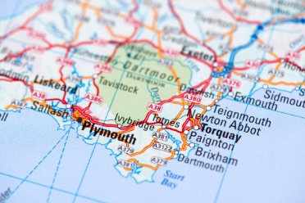
Rural Devon Deprivation Indices Mapping
A total population that is identified as marginally more
rural than urban,
A larger population situated in Rural Village and Dispersed LSOAs than Rural Town and Village.
Devon has 39 LSOAs in a Sparse context with a total population of 83,800
We have started working on Rural Deprivation Indices mapping in Devon and plan to collaborate on a National Rural Health Inequalities Research & Profiling programme this year.
We hope this emerging work will contribute to an “Insight Hub” with cross sector input

Slide 8
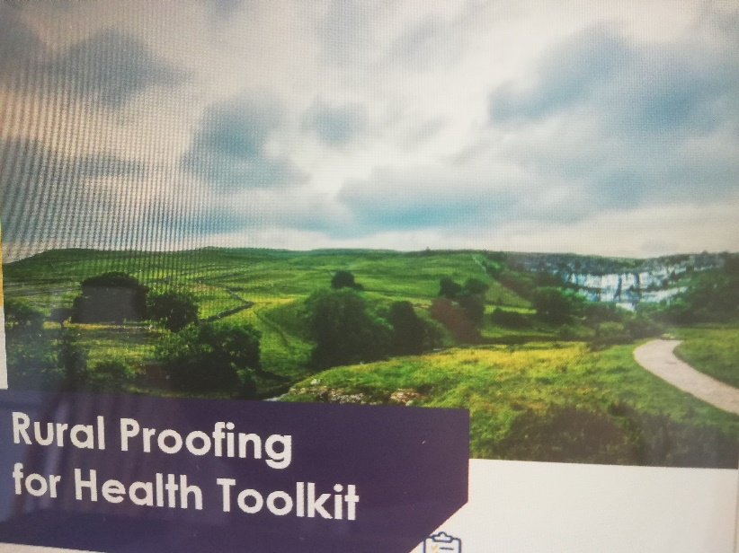
Rural Proofing for Health Toolkit
Potential for cross sector collaboration on testing applications of the Rural Proofing for Health Toolkit, published in December 2020, to help local organisations and partnerships in the health and care sector to take better account of rural needs. the Toolkit is based around 6 main themes:
Main hospital services
Primary and community health services
Mental health services
Public health and preventative services
Social care services
Workforce
ACRE, The National Centre for Rural Health & Care and Rural England CIC are developing a pilot offer to support training and facilitation in the applied testing & use of the Toolkit

Slide 9
Public Health report on Rural and Coastal Inequalities
Outline for addressing health inequalities by:
Community activities to encourage people to socialise and participate in community life.
Promoting physical activity and making use of natural assets.
Ensuring accessibility in design and delivery of health and social care services.
Services that reach people in their homes including place based volunteer and outreach programmes.
unity life.
Promoting physical activity and making use of natural assets.
Ensuring accessibility in design and delivery of health and social care services.
Services that reach people in their homes including volunteer and outreach programmes.
Community activities to encourage people to socialise and participate in community life.
Promoting physical activity and making use of natural assets.
Ensuring accessibility in design and delivery of health and social care services.
Services that reach people in their homes including volunteer and outreach programmes.

Slide 10
Roads to Renewal The role of the VCSE Sector
Gathering intelligence on local community lived experience, profiling resource need & capacity and identifying solutions to inform future funding and service development strategies
Building place-based partnerships to contribute to the improvement of health, wellbeing and inequalities reduction, to add value over and above the contributions of individual organisations or systems
Build up from what already exists locally by place based community engagement in a dialogue with public sector leaders aimed at locality based leadership in commissioning and procurement

