Slide 1
What does Carbon Net Zero (and the Biodiversity Crisis) look like in a rural church context? – Chris Keppie, Devon Churches Rural Forum, 8/2/21
Contexts
Resources
Discussion

Slide 2
Definition
“When we talk about “net zero carbon” we mean that:
the greenhouse gas emissions of the organisation have been radically reduced to a low level, by cutting waste and reducing energy use, AND
the remaining “residual” emissions have been reduced (by purchasing energy from renewable sources, from the ‘spare’ electricity we generate and export from solar panels and other renewables, and through offsetting such as tree planting or other forms of carbon capture), SO THAT
the organisation’s net greenhouse gas emissions are therefore now ‘net zero’. ”
From the Church of England paper on definition and scope of carbon net zero, June 2020. Much more detail here! – https://www.churchofengland.org/sites/default/files/2020-06/Defining%20Net%20Zero%20-%20national%20guidance%20-%20version%20ready%20for%20consultation%20FINAL%20June%2015th%202020.pdf
But………………..

Slide 3
1a. Context - Covid
How are we? (As individuals / leaders / churches…)
Exhausted?
Overly busy? Other more immediate priorities? (pastoral, spiritual, poverty, admin etc)
Anxious? Grieving? Frustrated? Ill?
Broke?
Compassion fatigue? Crisis fatigue? Rain fatigue?
Overwhelmed? Just about managing?
…
Empathy.

Slide 4
1b. – ‘An Inconvenient Truth’
Al Gore (2006), climate change ppt / film
Oxfam: “Climate change hits poor communities first and worst. It disproportionately affects those most vulnerable and least able to adapt to more frequent and more severe storms, droughts, and floods”
UNHCR “Climate crisis is the greatest ever threat to human rights. The economies of all nations, the institutional, political, social and cultural fabric of every state, and the rights of all your people, and future generations, will be impacted.” (Michelle Bachelet, United Nations High Commissioner for Human Rights, 2019)
NATO: “Having a capable army and rescue services will not be enough. The threat of mass casualties, political upheaval, and conflict within and between states will certainly increase.” (Gen Wesley Clark)
Antonio Gutterez, UN Sec-Gen, April 2020:
“On this International Mother Earth Day, all eyes are on the COVID-19 pandemic – the biggest test the world has faced since the Second World War. We must work together to save lives, ease suffering and lessen the shattering economic and social consequences. The impact of the coronavirus is both immediate and dreadful.
But there is another, deep emergency -- the planet’s unfolding environmental crisis.
Climate disruption is approaching a point of no return.
We must act decisively to protect our planet from both the coronavirus and the existential threat of climate disruption.
The current crisis is an unprecedented wake-up call. We need to turn the recovery into a real opportunity to do things right for the future.”

Slide 5
1b. Other world leaders
Joe Biden, 20/1/21: Day 1 – “Climate Day at the White House”
National security & foreign policy priorities
Climate change “existential” executive orders
rejoins Paris Climate Accord, cancels oil pipeline, reverses 100+ other actions
https://www.bbc.co.uk/news/world-us-canada-55829189
Boris Johnson, 12/12/20
“Climate change is a challenge far worse, far more destructive, even than coronavirus”
https://www.youtube.com/watch?v=gbngpksJaOA
David Attenborough, UN Climate Talks 2018
“We are facing a man-made disaster on a global scale. Our greatest threat in thousands of years”
NFU Deputy President, Stuart Roberts, 2021
“Our goal of net zero agriculture by 2040 means the industry as a whole being a net zero contributor to climate change. It is a challenge but by coming together to encourage progress it can be done, and it will also help improve our business resilience as well as our environment”
https://www.nfuonline.com/cross-sector/environment/climate-change/climate-change-must-read/26-ways-farmers-are-doing-their-bit-for-net-zero/

Slide 6
1b. Continued… Christmas Present (& A Perfect Planet, 2021)
David Attenborough #2, 2020
“This is the true tragedy of our time: the spiralling decline of our planet’s biodiversity… it could ultimately lead to the destabilisation and collapse of everything we rely upon… The natural world is fading. The evidence is all around… It will lead to our destruction.”
In his lifetime (since 1930s), loss of
70% of world’s wildlife population totals (not species)
In UK 500+ species lost
97% flower-rich meadows since 1930s..
“…Yet there is still time…”

Slide 7
1c. Context – Churches
Dave Bookless, A Rocha International (Director of Theology), CofE Environment Working Group, World Evangelical Alliance Creation Care Network etc.
45 min brilliant presentation at Arthur Rank Rural Officers Gathering, Nov 2020: https://youtu.be/jDcxM7Ymt2M
“Perfect Storm” of related crises (all current + projected increase)
Biodiversity loss
Climate change
Soil erosion, desertification, infertility
Water scarcity
Meat eating (96% of animal biomass is humanity/human’s livestock-60%) – only 4% wild.
Huge population growth
Related famine, wars, alien introductions/diseases, market failures, mental health (suicide ‘epidemic’ in Indian agriculture)
Importance of Land
29 of 46 promises to OT patriarchs are about land (von Rad). “Relationship to God and relationship to land are inseparable – shocking to many urban ordinands - we’ve over individualised and over spiritualised the gospel”. Bruegemann’s The Land. “Earth groaning” (Romans 8). Not gaia worship… but so much anthropomorphic imagery of land in the bible.
Not just about us!
“The earth is the Lord’s and everything in it” (Psalm 24) ‘We are leaseholders not freeholders’. ‘Dominion’ profoundly misinterpreted.
The Ark: so many species rescued, incl those inedible or ‘unclean’ – regardless of use for humanity, all creation is intrinsically valuable

Slide 8
1c. Context – Churches
Pope Francis, 2015 - Laudato Si
Referencing St Francis, for whom our common home is like a ‘sister’; as all creatures brothers and sister
“This sister now cries out to us because of the harm we have inflicted on her by our irresponsible use and abuse of the goods with which God has endowed her...
“Francis shows us just how inseparable the bond is between concern for nature, justice for the poor, commitment to society, and interior peace”
Broad denominations’ EcoChurches (& Synagogues & Mosques) & fossil fuel di(sin)vestment, etc
++Justin Welby, Oct 2019 – Environment Working Group paper; LiveLent2020
“It’s our sacred duty to protect the natural world we’ve so generously been given, as well as our neighbours around the world who will be first and worst affected. Without swift decisive action the consequences of climate change will be devastating.”

Slide 9
1c. Context – Churches cont.
CofE General Synod, Feb 2020
Resolved:
“that this Synod, recognising that the global climate emergency is a crisis for God’s creation, and a fundamental injustice… call upon all parts of the Church of England, including parishes, Bishop Mission Orders, education institutions, dioceses, cathedrals, and the National Church Institutions, to work to achieve year-on-year reductions in emissions and urgently examine what would be required to reach net zero emissions by 2030 in order that a plan of action can be drawn up to achieve that target…”
Scoping definition, webinars & resources, network of DEOs, DEG etc

Slide 10
1d. Context – Personal
Diocesan Environment Officer (and Church & Society Officer)
Not a scientist / ecologist!
PhilThe… Simplicity/challenge of Amos 5
“I hate your religious feasts…Take away from Me the noise of your songs! I will not listen to the music of your harps. But let justice roll on like a river, and righteousness like an ever-flowing stream.”
Social housing, homelessness etc
(China 2000-2: black snot & weeds…)

Slide 11
Harbin, N.China, -30

Slide 12
Harbin, China #2. 10m people

Slide 13
Wonder
Gratitude
Hope
Action

Slide 14
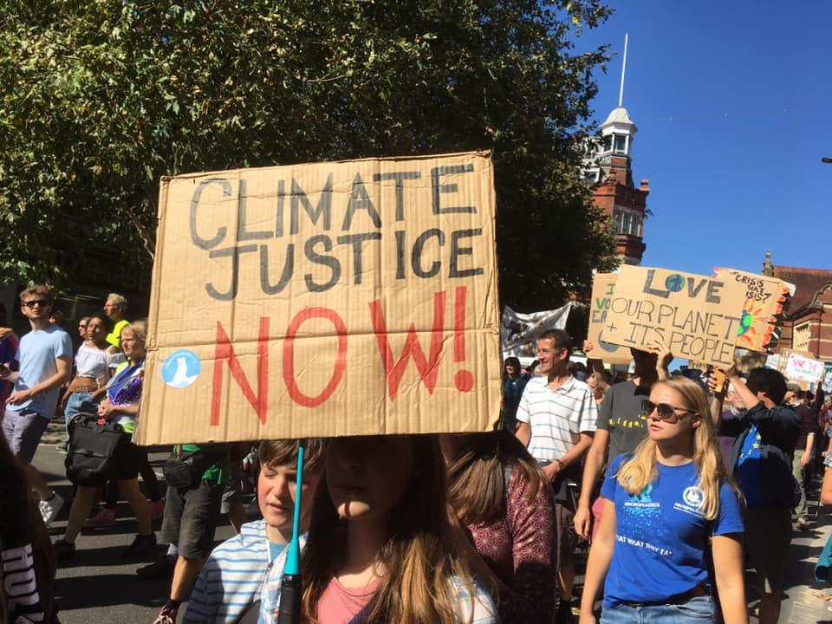
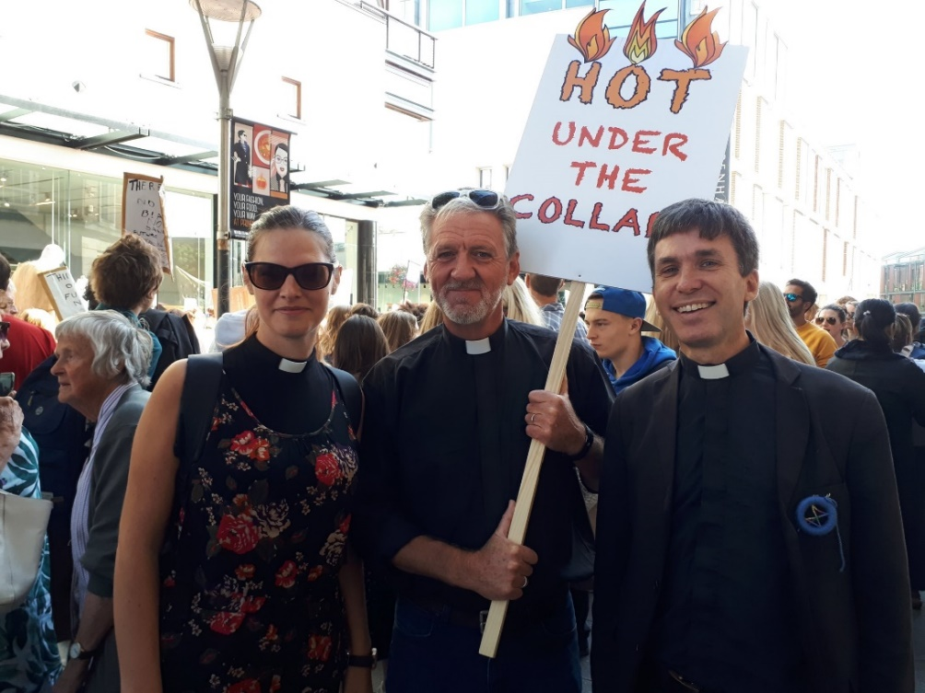
1d. Context – Personal
Then personal energy, flying, Green Party, marches, community supported agriculture etc, community living… (but other work)
2019: Anglican diocese Church & Society, including Environment
(apologies for Anglican focus – hopefully relevant to all!)

Slide 15
1e. ‘Marks of Mission’ – further positives!
To proclaim the Good News of the Kingdom
To teach, baptise and nurture new believers
To respond to human need by loving service
To seek to transform unjust structures of society, to challenge violence of every kind and to pursue peace and reconciliation
To strive to safeguard the integrity of creation and sustain and renew the life of the earth
Environmental Actions:
Credibility. Relevance. [5, all]
Sympathy, interest, involvement of non-churchgoers / “fringe” (in churchyard/land management, community food projects, energy/travel/recycling projects etc) – Love! New believers? (cf Theos GRA:CE report) [1,2]
Good £investment?! Increased energy efficiency + numbers… [2]
Loving global / future neighbours (and non-human!) in adapting to and mitigating climate/biodiversity crises [3,4]
Projects & spaces positive re mental health, physical health, loneliness, employment, poverty, peace here & now! [3,4]
“‘To strive to safeguard the integrity of creation, and sustain and renew the life of the earth,’ is one of the Five Marks of Mission.
“If it is not embraced wholeheartedly and with determination, the other four marks of mission lack credibility. The stewardship of creation is integral to our evangelism and mission.”
- Bishop Robert Atwell, 2020

Slide 16
Melanesian Mission (S.Pacific / Devon)
Walande island:
2002 - 1200 residents
2016 - 4 (rest moved next to rubbish dump) – photo
2020 - entirely disappeared
https://youtu.be/k2_GzkUne7g
www.mmuk.net
Devon history & base

Slide 17
1e. Overwhelm… to Positives
“What shall we say the kingdom of God is like, or what parable shall we use to describe it? It is like a mustard seed, which is the smallest of all seeds on earth. Yet when planted, it grows and becomes the largest of all garden plants, with such big branches that the birds can perch in its shade.” (Mark 4)
“Q: What must I do to inherit eternal life?...
A: … Love the Lord your God with all… and love your neighbour as yourself” (Luke 10)
Active, reactive, proactive; different; challenging….
But also do-able actions of 1 person for 1 person!
“EVERY ACTION COUNTS”
challenging + empowering!
biodiversity (mustard!), carbon emissions, etc
societal / spiritual Kingdom of Heaven

Slide 18
2. Resources/Opportunities (NB “Every Action Counts!”)
EcoChurch (CC - Climate Change, BD - Biodiversity, all)
Practical Path To Net Zero (CC)
Parish Buying – Energy Basket (CC)
CofE Environment Carbon Net Zero Webinars (CC)
Funding (all)
Living Churchyards & Caring For God’s Acre (BD)
CPRE Competition (BD)
Love Your Burial Ground Week (BD)
Energy Footprinting Tool(kit)
Offsetting (CC)
Fairtrade & food more generally (CC, BD)
Campaign / support groups
Books, powerpoints, courses, websites (all)
Worship – Liturgy, Doxecology, Climate Sunday , COP26 (BD, CC)
You! - Please share successes via Diocese Community facebook group etc or chris.keppie@exeter.anglican.org

Slide 19
2.1 EcoChurch
A self-accreditation scheme run by A Rocha UK: https://ecochurch.arocha.org.uk/
Launched Jan 2016 by Rowan Williams in St Paul’s Cathedral (with Christian Aid & Tearfund)
“Our vision is for churches of all denominations to care for creation as an integral part of loving their neighbours and following God faithfully.”
By completing a free, online survey, churches/cathedrals/dioceses of all denominations can be considered for an Eco Church Award at either Bronze, Silver, or Gold level. Push/pull to move forward!
Five areas that a church must demonstrate environmental engagement with to receive an award:
Worship and teaching.
Management of church buildings.
Management of church land.
Community and global engagement.
Lifestyle.
All five areas have brilliant online resources - * https://ecochurch.arocha.org.uk/resources/ *
5 year aim to reach 10% churches (4500) in 10 years (tipping point to normal).
Jan 2021: 3100 registered; 1000+ awards. 5 year anniversary service open to all, March 26th

Slide 20
2.1 EcoChurch cont.
Church of England EcoChurches interviews and casestudies (listed by the 5 categories) from across England:
* https://www.churchofengland.org/about/policy-and-thinking/our-views/environment-and-climate-change/our-stories/eco-church#na *
Including Devon’s:
Lee Abbey (Energy): hydro-electric turbine & solar PV; plans for biomass & airsource heat pump
St Edward’s, Eggbuckland (Biodiversity): Living Churchyards – lichen, moss; diversity of trees/shrubs; mowing to allow wildflowers; biblical herb garden; bird/bat boxes etc http://www.stedwards.church/contacts-before-import/churchyard-2-before-import/

Slide 21
2.2 Practical Path to Net Zero (2030)
Produced by C of E Environment, 2020 – following General Synod Carbon Net Zero 2030
Concise suggestions broken down into quick & easy first actions…moving through to ‘What Next’ possibilities to get to net zero.
Relevant for all churches, denominations or faith communities, and much is useful thinking for all buildings!
6 key principles: Well Maintained, Buy Renewable, Waste Less, Electric (not gas/oil), Generate, ‘Offset The Rest’
* https://www.churchofengland.org/sites/default/files/2021-01/the-practical-path-to-net-zero-carbon-numbered-Jan2020.pdf *
Online checklist: * https://www.churchofengland.org/sites/default/files/2021-01/PP2NZC_SelfGuidedChecklist_onscreen_version.pdf *
Paper checklist: https://www.churchofengland.org/sites/default/files/2021-01/PP2NZC_SelfGuidedChecklist_print_version.pdf
NB +Nick Holtam, 2020 Exeter Big Green Event:
“I’m a recovering carbon user…” Ambitious target, but we must get as close asap…

Slide 22
2.3 Parish Buying – Energy Basket
From https://www.parishbuying.org.uk/index.php/categories/energy/energy-basket :
Save money - a price based on wholesale energy purchasing
Save time - it’s a long term solution. There’s no need to renegotiate every time a contract comes up for renewal
Save the environment - 100% of the electricity in the Energy Basket is green, all from UK-based renewable sources. We’ve been working with the Basket provider to do this at no extra cost to our members
Feel supported - our wonderful customer service team can help you every step of the way
See also EcoChurch resources page on Green Energy Suppliers (principles, recommendations, incentives!)

Slide 23
2.4 CofE Environment Net Zero Webinars
Maintenance & electricity switch easy… But gas/oil heating! (huge proportion)…
… So…Webinars: overviews, casestudies, technical, funding, DAC Faculty requirements, Q&A (and recorded). Free, but must book. ca 1 hour. Open to all!
* https://www.churchofengland.org/about/policy-and-thinking/our-views/environment-and-climate-change/webinars-getting-net-zero-carbon#na *
Positive Vision Overview, Energy Management, Housekeeping & Quick Wins – all on video
Forthcoming dates of new live session to look out for (but often repeated):
Solar PV & batteries Tuesday 9th February, 4-5pm - register here
Effective Management of Lighting Thursday 11th March, 4-5pm - register here
To Replace Or Not To Replace (heating, lighting etc) Tuesday 16th March, 12-1pm - register here
Choosing The Best Heating Solution For Your Church Tuesday 20th April, 12-1pm - register here
Funding overview - tbc

Slide 24
2.5 Funding
Church of England funding guide, has a large environmental projects section: https://www.parishresources.org.uk/wp-content/uploads/Charitable-Grants-for-Churches-Jul-2020.pdf
For rural churches and schools, it’s also worth looking at the Rural Community Energy Fund: https://www.gov.uk/guidance/rural-community-energy-fund
For solar (etc) be aware of the Smart Export Guarantee Scheme, which has partly replaced the Feed in Tariff : https://www.ofgem.gov.uk/environmental-programmes/smart-export-guarantee-seg/generators
Needs so varied; funds change… CofE Environment hope to update Practical Pathway & new webinars – look out. Funding consultant? And please share successes via me!
Remember Energy is only one of 5 EcoChurch areas (also Worship/Teaching, Land, Community/Global, Lifestyle); and remember (church) investments! See A Rocha Ethical Investment resource

Slide 25
2.6 Caring For God’s Acre & Living Churchyards
(… often needs very little funding! May even save money!)
Devon Living Churchyards
David Curry is the diocese’s volunteer environment adviser who, along with an ecumenical group of experts, has written a set of guidance notes on topics such as bees, pesticides, swifts, trees, and wildflowers in churchyards; as well as an overview, and template habitat action plan.
Please see these notes and templates, download, and use! https://drive.google.com/drive/folders/1BOGPahE8F1a-_CF3LQvFUjPLluugVTIb
David and others also offers bespoke advice to churches across the diocese to help create plans to best care for and welcome wildlife, whilst also engaging communities and promoting good mental and physical health. Please contact for phone/email advice or a Zoom/in-person visit via dcurry.devongreenchurches@gmail.com
‘Caring For God’s Acre’ is a national charity which helps maintain and restore biodiversity of churchyards (special and often unique habitats / ‘refuges’) as well as their positive use and accessibility for all (incl St Mary’s Throwleigh..) Resources * https://www.caringforgodsacre.org.uk/resources/ *

Slide 26
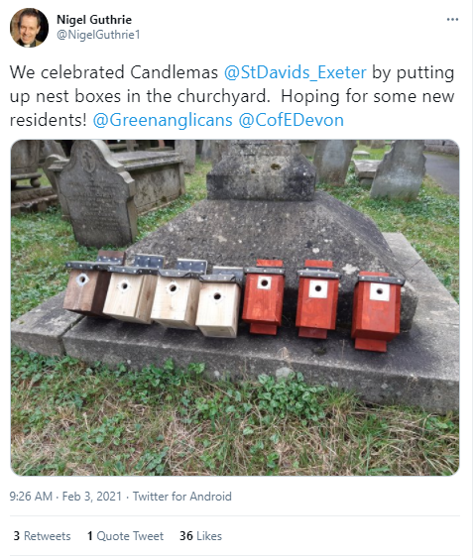

Slide 27
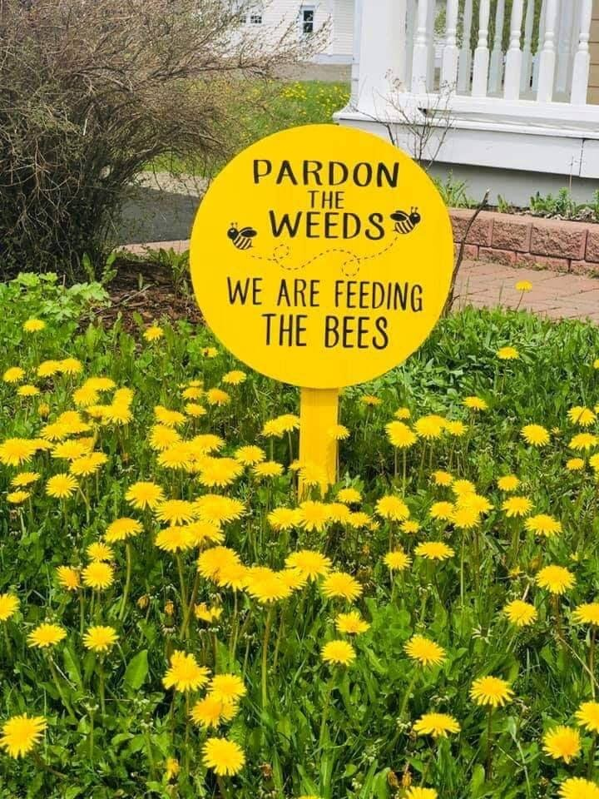

Slide 28
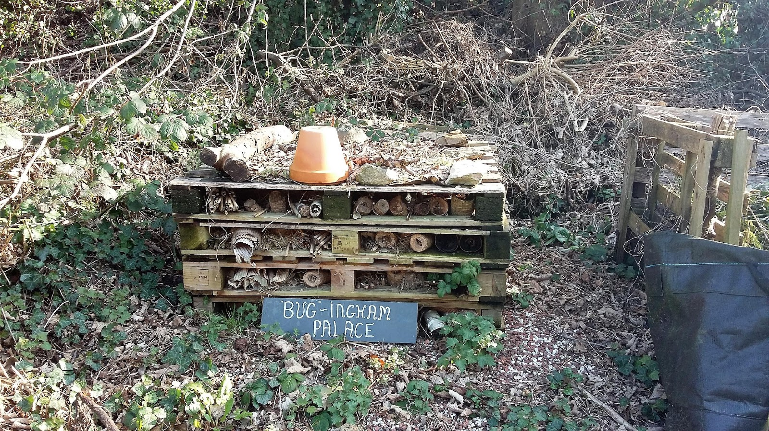

Slide 29
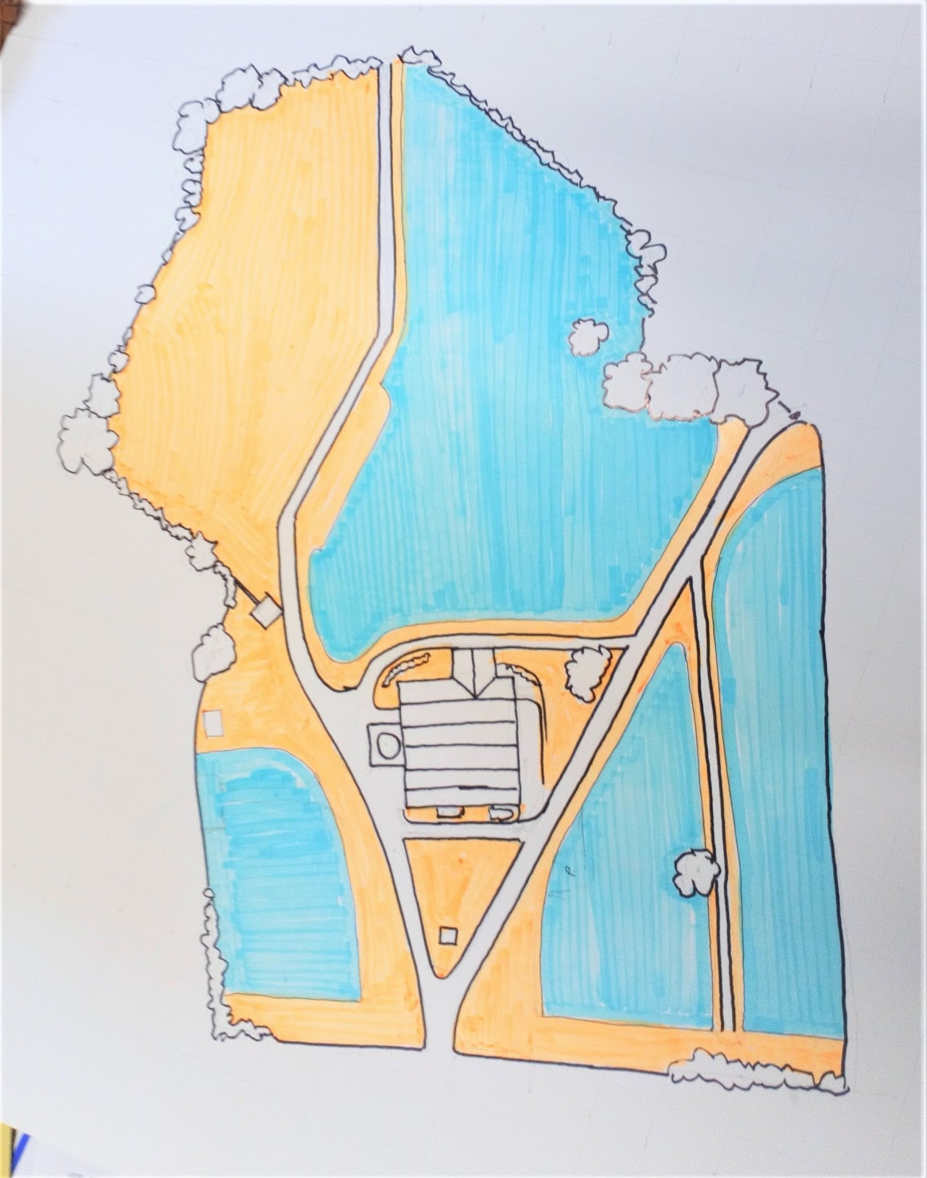
Sketch plan of Hatherleigh Church, Okehampton
Area: 2 acres
Orange area is where graves are currently visited and will be cut to a short sward.
Blue areas will be cut in the Autumn only and managed for wildflower meadow.

Slide 30
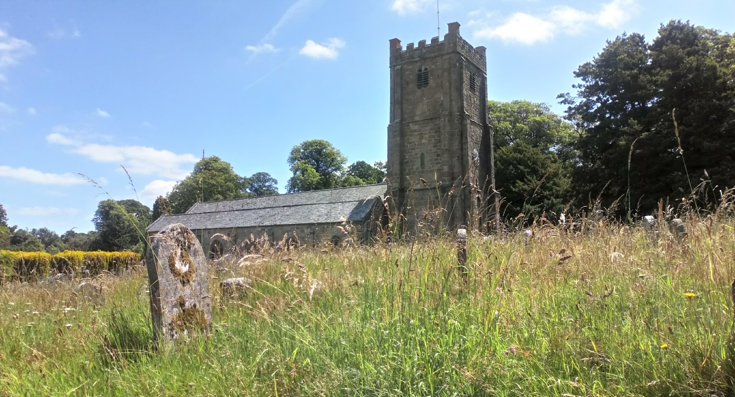
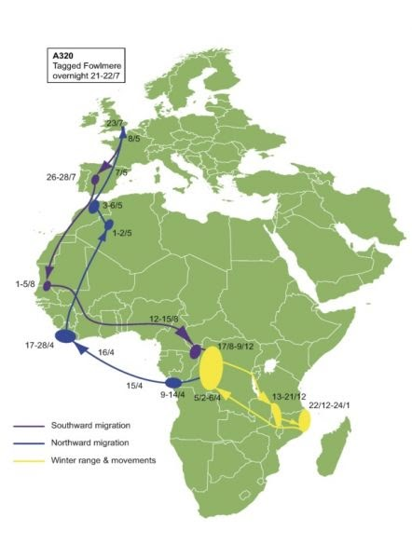
Swifts migrate here from Africa in May.
3,100 miles in 5 days
Chagford church has installed swift nest boxes in tower and play swift soundtrack to attract birds

Slide 31
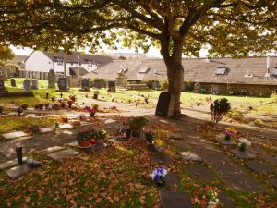
2.7 CPRE Devon Best Churchyard Competition
https://www.cpredevon.org.uk/competitions/devons-best-churchyard-competition/
St Mary’s, Northam (2020 winner)
£200, plaque, kudos!
Engagement. Positive celebration / progress.
Biodiversity, beauty, accessibility, peace – “sanctuaries”
“well-managed to provide a peaceful haven for people and wildlife”
Deadline 31st March 2021
2020 Runner Up: St Swithun’s, Sandford. Highly Commended: All Saints’, East Budleigh and Point in View Chapel, Exmouth

Slide 32
2.8 Churches Count On Nature Week
Sat 5th – Sun 13th June: Love Your Burial Ground Week
Collaboration of Caring For God’s Acre, A Rocha, Church of England
Events unlikely this year... But individuals’ biodiversity count is hopefully still possible (NB current Covid rules, so don’t promote community events)
For broad information: https://www.caringforgodsacre.org.uk/about-us/calendar/love-your-burial-ground-week/#:~:text=The%20last%20point%20is%20important,the%20second%20week%20of%20June
Contact David Curry dcurry.devongreenchurches@gmail.com to receive Devon Wildlife Trust’s Biodiversity Recording Centre new toolkit to record a snapshot of wildlife recorded. Data will be fed into the national ‘Churches Count on Nature’ project

Slide 33
2.9 Energy Footprint Tool(kit)
As Churches Count On Nature (or Big Garden Birdwatch etc), baseline monitoring is vital – to understand local/national picture, understand action requirements, & celebrate progress…
Carbon Net Zero 2030 Energy Footprint Tool for CofE churches: by adding information on Parish Returns from last year’s bills for your church (and hall) to pre-populated data, you receive energy efficiency ratings based on size and attendance, tips to make carbon savings, and annual progress updates
2020 (for 2019): first year asked – 36% engagement
2021: from March: info & video here: https://www.churchofengland.org/about/policy-and-thinking/our-views/environment-and-climate-change/about-our-environment/energy-footprint-tool - please promote to treasurers
(likely to expand to include cathedral, clergy housing, education etc, as part of wider scope)
Huge importance (cf Marks of Mission quotes), even if more boring than Big Garden Birdwatch!

Slide 34
2.10 Carbon Offsetting
“Reduce what you can. Offset the rest”
Not like pre-Reformation ‘indulgences’!
Reduction of carbon (& other GHGs) overwhelming focus; but not all current emissions ‘can’ be eradicated – now / by 2030 / 2050 even?
Previous personal / church / national carbon debt?
Offsetting projects benefit
Communities in developing countries (hit ‘first and worst’ by climate change)
Biodiversity
Diocesan position tbc. But individual consideration nevertheless needed for national 2030 ambition? By then/sooner/now?
See https://www.climatestewards.org/ for footprint calculator (for individuals and churches – new), info on global projects, offsetting

Slide 35
2.11 Fairtrade & food more generally
‘Fairtrade’: social justice includes climate justice (eg average person in Cote d’Ivoire has 1/21 carbon footprint of person in UK, but far worse affected)
Agricultural impacts (eg on coffee/cocoa/banana farmers) include:
More volatile seasons – less predictability
Heavier rains/floods, more droughts, weather extremes – fungal diseases etc
Already v low margins – but declining yields, and adaptation costs etc
Deforestation, soil erosion, rising sea et al – less land, higher costs, migration, war
Fairtrade.org.uk climate pages (videos, ppts etc)
Buy and promote Fairtrade!
Standards: PREVENTION: reduce emissions, prohibit deforestation, tackle soil erosion..
‘Premium’ –helps farmers’ survival, sustainable investment, community ADAPTATION
https://exeter.anglican.org/resources/faith-action/fairtrade-food/ for info on becoming a Fairtrade church, local providers, Fairtrade Fortnight (22nd Feb – 7th March)

Slide 36
2.11 Fairtrade presentation

Slide 37
2.11 Fairtrade & food more generally – cont.
Church connections to low carbon food?
Foodbanks / larders:
fresh produce also (avoid food waste/miles + quality nutrition + resilience)
Herb gardens / raised beds / allotments in church land (or walls!):
good for biodiversity + community engagement + mental/physical health + above!
(DAC!)
Promotion
Buy local (lower carbon + economic resilience + mental health)
Farmers markets, co-ops, CSAs etc
Food (etc) packaging recycling points
Terracycle
(Prevention + adaptation: as Fairtrade approach, and more broadly!)

Slide 38
2.12 Campaign / support groups
Christian Aid Week 10-16th May 2021 (climate crisis).
Changemakers Conference 22-26th Feb
CAFOD Climate Campaign
Tearfund Reboot Campaign (climate)
…
Christian Climate Action (XR) – non-violent direct action, prayer, support
Green Christian – varied resources, incl Borrowed Time (pastoral support for “eco-anxiety”, “climate grief”)
Operation Noah – focus on carbon divestment, and Climate Sunday
…

Slide 39
2.13 Books, courses, materials from 2020!

Slide 40
Saying Yes To Life - Ruth Valerio (Global Advocacy & Influencing Director, Tearfund)
Archbishop of Canterbury’s 2020 Lent Book (best-selling ever!)
Structured around the Days of Creation, she relates themes of light, water, land, the seasons, other creatures, humankind, Sabbath rest and resurrection hope to matters of environmental, ethical and social concern.
Powerful scriptural exegesis of these ‘Days’; delight and awe at the wonder of life in all its variety; ecological and climate science presented authoritatively and accessibly; personal stories, and international perspectives of poverty, inequity and positive developments and possibilities; and crucially, urgent exhortations for us all to Act.
Book still available here; free course, video interviews with international scientists and archbishops, and wealth of online related resources here.
2020 #LiveLent environment 40 day challenges (adult / children)
Still relevant, brilliant, available here!
The Big Green Event, Exeter Cathedral:
News piece, photo album, and some of the powerpoints

Slide 41
2.14 Last but not least… Worship
“A Time for Creation – Liturgical resources for Creation and the Environment” 2020
full of liturgical resources for creation and the environment, from the national Liturgical Commission, chaired by +Robert Atwell (Exeter)
“encourages us to praise God for his creation, take responsibility for our actions, repent of our misuse of natural resources and hear the voice of creation itself in our prayer…
“Drawing together texts from Common Worship with newly commissioned material, it offers liturgies for all times and occasions.”
Doxecology 2020 album
“worship songs that celebrate the wonder of creation, acknowledge our failures, and anticipate a glorious restoration in Christ”
accompanying study guide. Musical scores, videos etc also available.
Climate Sunday - new global ecumenical campaign
churches encouraged to have at least one Sunday in the year from 6th September devoted to the theme of climate change, culminating in a national service on 5th September 2021
Resources include a wealth of links for music & hymns, readings, sermons, orders of service publicity, etc.

Slide 42
2.15 Please share!!
EcoChurch accreditation?
Climate Sunday date?
Completed Practical Pathway To Net Zero checklist?
New energy source? Funding?
Interaction with school?
EV charging point at church?....
Please share via Diocese Community facebook group etc or chris.keppie@exeter.anglican.org

Slide 43
3. Discussion Questions
What stories/experiences can you share about what is already happening with respect to climate change in your church/community?
What are the challenges you perceive both in the generation of emissions/energy usage etc; and positive solutions in your church/community?

Slide 44
4. Resources/Opportunities (NB “Every Action Counts!”)
EcoChurch (CC - Climate Change, BD - Biodiversity, all)
Practical Path To Net Zero (CC)
Parish Buying – Energy Basket (CC)
CofE Environment Carbon Net Zero Webinars (CC)
Funding (all)
Living Churchyards & Caring For God’s Acre (BD)
CPRE Competition (BD)
Love Your Burial Ground Week (BD)
Energy Footprinting Tool(kit)
Offsetting (CC)
Fairtrade & local food (CC, BD)
Campaign / support groups
Books, powerpoints, courses, websites (all)
Worship – Liturgy, Doxecology, Climate Sunday , COP26 (BD, CC)
You! - Please share via Diocese Community facebook group etc or chris.keppie@exeter.anglican.org

