Slide 1
TTVS AGM 2019
Hannah McDonald
Partnership Development Manager
One Northern Devon
Senior Fellow for the SW Institute for Social Prescribing

Slide 2
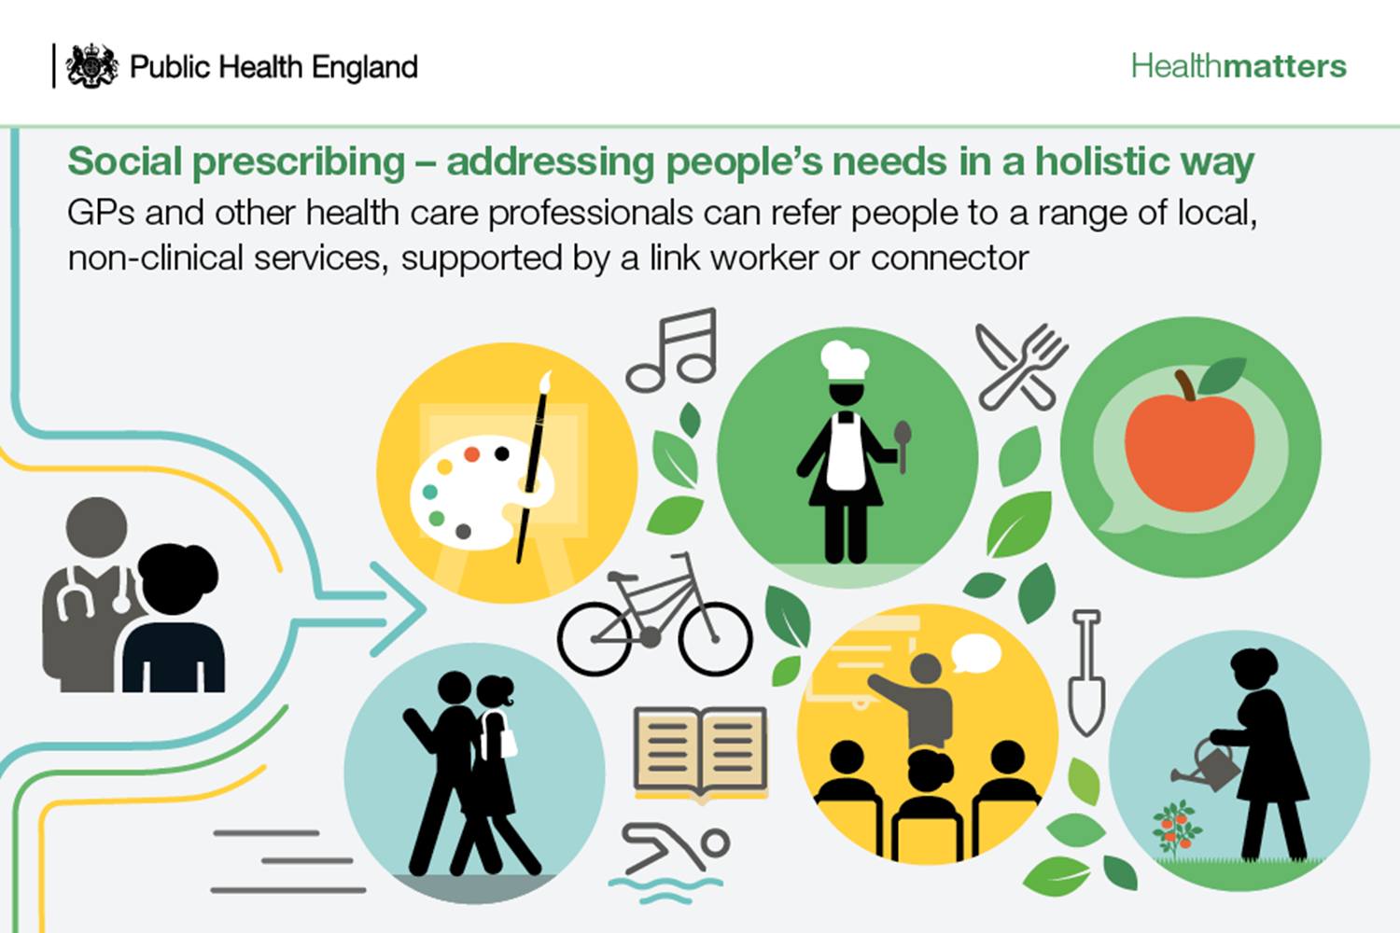
What is Social Prescribing?
It enables people to take control of their own healthcare choices and engage in non-clinical forms of support.
‘Solutions are more than medicine’

Slide 3
Why is it needed?
NHS England has backed Social prescribing as one of its 10 high impact actions which are aimed at freeing up GP time to enable them to deliver more clinical care
Analysis by Royal College of GPs found that SP was among the most effective of these 10 high impact actions at reducing GP workload.
University of Westminster study found that SP was associated with a 28% reduction in GP appointments and also helped to cut A&E and outpatient attendances*
Social Prescribing also helps to further improve connectivity between groups and organisations within a community

Slide 4
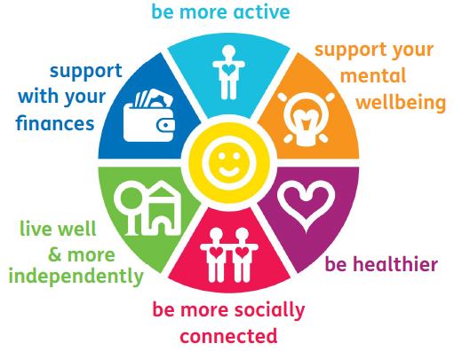
What sort of things can the Social Prescriber help with?
Connecting local residents to local groups, services and opportunities to help support their health and wellbeing

Slide 5
Examples where social prescribing can help
Case study | Social prescriber intervention
Person A has been to see their GP. His wife had just passed away and all extended family were at a distance. He has spent last few years caring for his wife and so social networks are now limited and was feeling lonely and isolated. | The SP talked through with person A about what they enjoy doing and suggested a number of local social groups. He was also given contact details for bereavement charities specifically for men to meet other people in a similar situation.
Person B was suffering from depression and anxiety. His GP felt that the client being lonely and isolated had added to these issues so referred him to the Social Prescriber. | The SP talked to Person B and discovered that he used to go to walking and fitness groups when living elsewhere. The SP discussed options in the local area and provided details of the local walking for health group which he didn’t know existed before. Now he attends regularly.
Person C was struggling to look after his wife who has dementia and needed support to enable her to remain at home with | The SP signposted person C to Care Direct, Devon Carers, Musical memories and the local Memory Café. He has now received a care package, support from Devon Carers, and he takes his wife to musical memories. He now has more of a social life and feels supported to stay living at home with her.

Slide 6
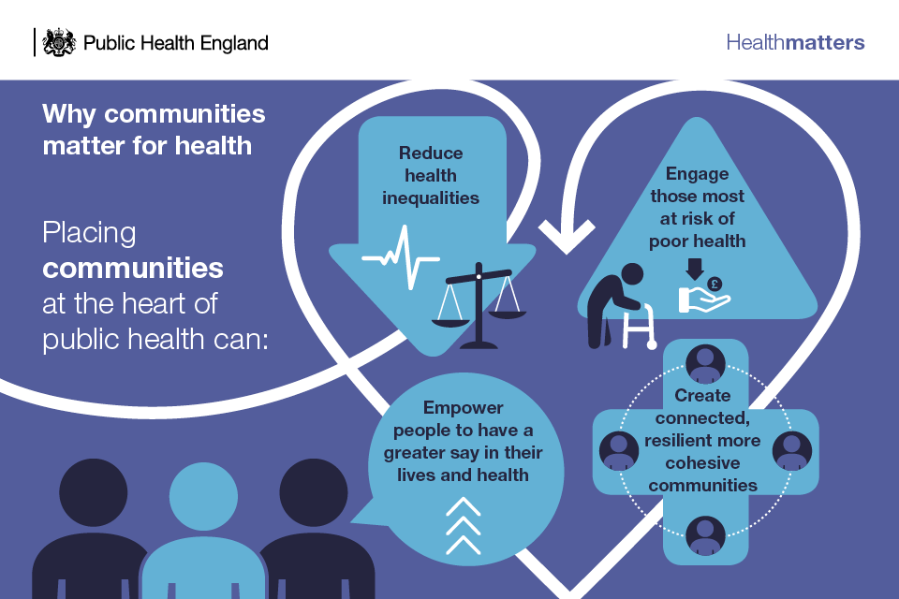
Social prescribing and the Community

Slide 7
What good social prescribing looks like for the Community
Communities work with social prescribing to ensure that services are fully accessible to all communities, including those in greatest need, who may be hardest for agencies to reach.
Communities are stronger and more tolerant, because people from all backgrounds are supported through social prescribing to be involved in community groups. There are more people who volunteer and give their time back to others.
Communities recognise that the NHS, local authorities and statutory services alone cannot meet all people’s support needs. This understanding releases energy across all stakeholders in addressing the wider determinants of health.
Communities understand the power of social prescribing in reducing health inequalities, by supporting a power shift, enabling people to take more control of their lives, be less isolated and make connections.
Communities are actively involved in developing and delivering social prescribing. VCSE organisations such as advice agencies are commissioned to receive referrals and deliver services. Local community groups are able to take referrals from link workers because they have sustainable grant funding.
Communities are aware of how social prescribing encourages community development and increases local community assets. Resources and support are available locally to spot gaps in community provision, help people to create new groups and provide informal support in their neighbourhoods.
Communities support the improvement of health literacy of professionals and local residents through social prescribing service development and referrals.
Communities are able to support people who participate in social prescribing, improving their confidence and ability to manage their own wellbeing.

Slide 8
Social Prescribing across Torridge Primary Care Network
From 1 July 2019, Primary Care Networks were launched in Devon. General practices in Northern Devon are all covered under one of 4 PCN’s (North Devon Coastal, Barnstaple Alliance, Torridge, Holsworthy Bude and Surrounding Areas).
PCN’s will support each other whilst also taking on a wider range of health professionals including a Social Prescribing link worker.
Trudi Mackie-Brown has recently been employed by Torridge Primary Care Network as a Social Prescribing link worker covering –
Castle Garden Surgery
Torrington Medical Centre
Northam Surgery
Bideford Medical Centre
Hartland Surgery
Wooda surgery.

Slide 9
https://livewellinbraunton.co.uk/wp-content/themes/custom/img/logo.jpg
The people that best understand communities are the people who live and work in them. One Communities are local partnerships that bring residents and service providers together to work on things that matter to their community.
One Northern Devon is supporting the development of One Communities in each of the six main towns in Northern Devon. Four are now established, plus one village.
Notes:
Explain one Communities
Function – to bring together organisations, residents and the voluntary sector to work together in a place based structure to create local solutions to local issues.
One Ilfracombe has now been in place for 6 years, One Bideford for 3 years and One Barnstaple for the last year.
Links with PCN’S
One Northern Devon supports the development of the One Communities through…
Q: What else is happening in NorthernDevon?
A: There are similar projects at various stages of development throughout Northern Devon. Ilfracombe and Braunton already have more established groups, OneBideford is already well supported, and groups are rapidly gathering strength in places like Torrington, South Molton and Holsworthy

Slide 10
Need for Community Development to support Social prescribing
Model piloted in Ilfracombe and Torrington through One Northern Devon
Community Development supporting Social Prescribing
Need to further support Community Voluntary sector to ensure they have the capacity to deal with social prescribing referrals
Identifying gaps in service provision and working to fill these
Torrington 100 Community Developers focussing on Arts and Health and Wellbeing
OND bid to add in Community Development across the rest of Northern Devon to support Link Workers

Slide 11
How does it all fit?
PCN Social Prescribing link worker
Community Development Officer employed through CVS
One Community
Torridge PCN
One Bideford
Torrington 100
TTVS
Community Groups and organisations

Slide 12
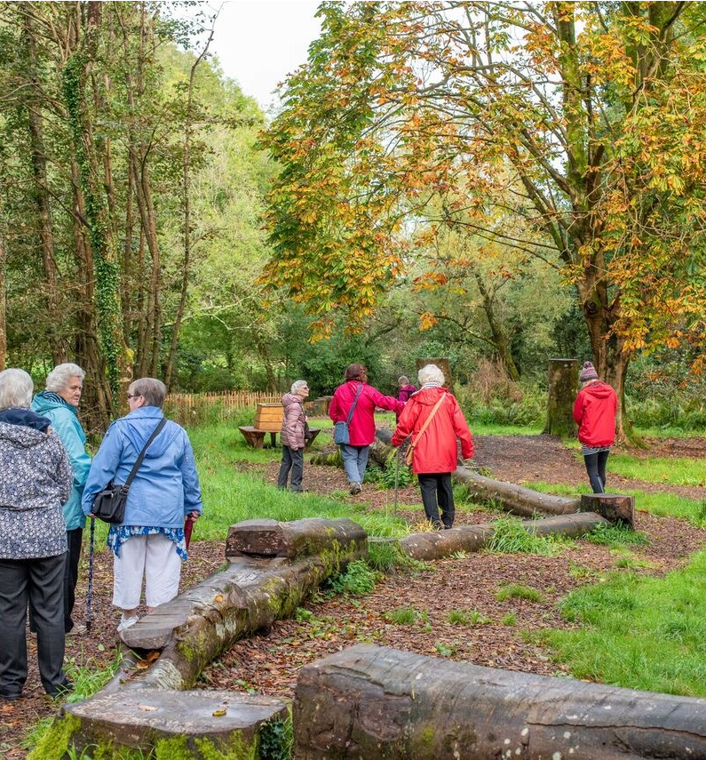
What are the Communities doing for Community Development ?
One Ilfracombe
Tackling social isolation through developing a ‘Parks and Gardens’ tour for older residents using funding from Active Devon.
Developing a Men’s shed
Mental health exercise groups getting people outdoors
Working with the National Trust to encourage more people to take up their free projects
Torrington 100
Community Developers focussing on arts, working on understanding the rural communities on the outside of Torrington. Mapping assets and identifying gaps in provision.

Slide 13
How can TTVS/Community Organisations support this work
TTVS already are! TTVS will be the employer for the Community Development Officer working in Bideford
Other community groups and organisations can connect with this new role to identify gaps in provision and also link with the new Social Prescribing Link Worker

