Slide 1
The GRA:CE Project
Growth, Relationship and Action in the Church of England
Hannah Rich, November 2019

Slide 2
Key questions
What does church growth look like in real life?
(How) does social action help churches grow?
(How) do people grow as disciples as they connect with others and with the church through social action?
How do local churches help people find greater freedom and agency?
What difference does place make in all of this?
Mixed methods approach
Qualitative and quantitative, stories and statistics.

Slide 3
Qualitative phase
66 case study parishes, over 320 interviews.
At least one parish in every diocese – broad range of geography, church size, tradition, growth pattern and deprivation.
Not doing the actual counting – other studies do that.
Broad definitions of the three aspects – church growth, social action and discipleship.
Social action is bigger than just ‘projects’.

Slide 4
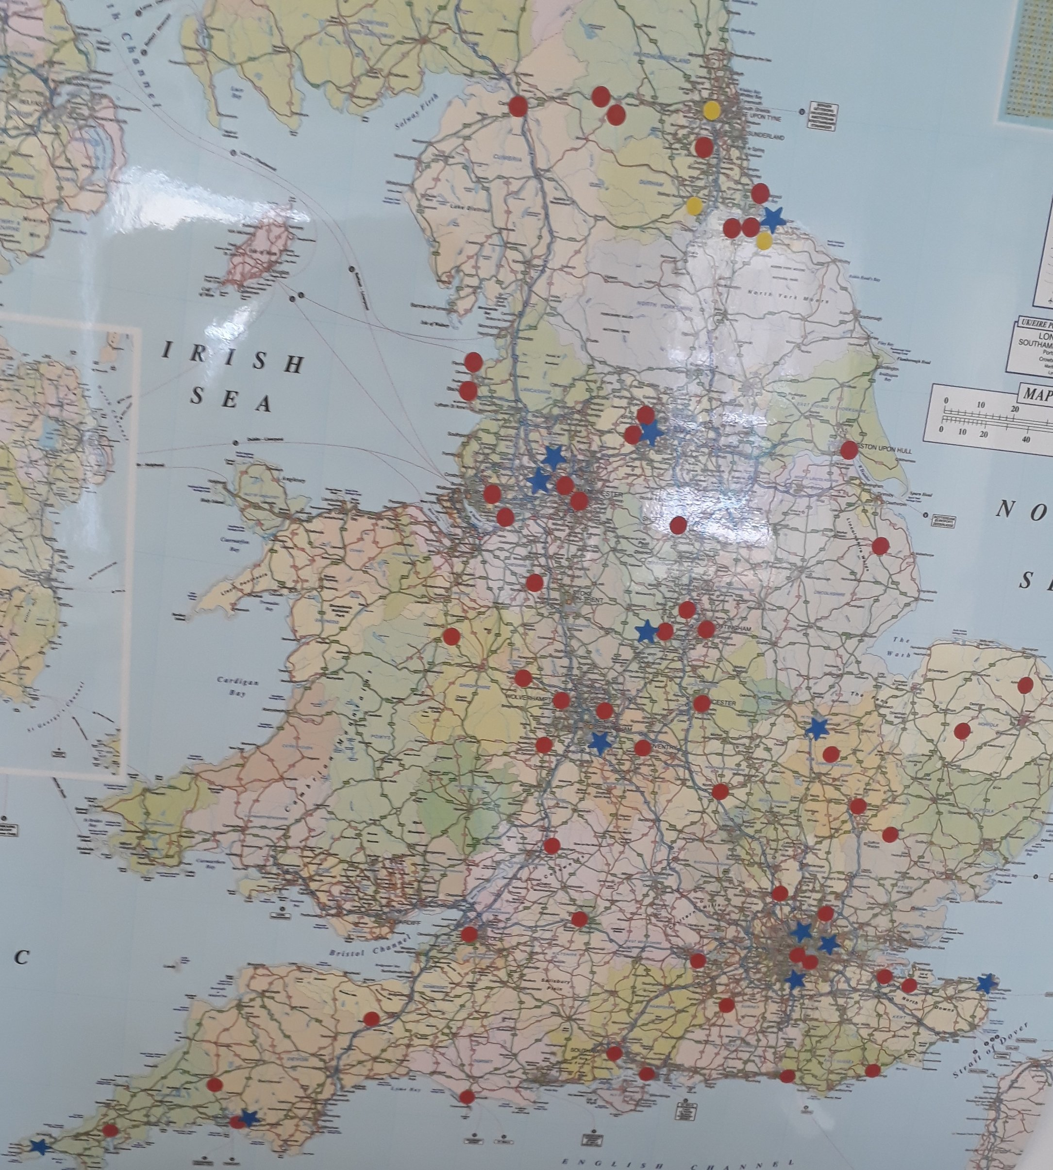

Slide 5
Initial observations
Churches ARE growing, despite the headlines.
Growth in presence, depth, diversity not just size.
Growth through engagement with local organisations.
No single recipe for growth but building relationships in the local community is central in many contexts.

Slide 6
Initial observations
Important that the church is known for social action.
People’s first experience of church may come through engagement with social action, in different ways and directions.
“When I heard about the refugee work, I just thought, ‘this is a church that’s actually living out the gospel and I have to go and see what’s happening. So I did and I’ve never left.”
(Congregation member, Truro)

Slide 7
Initial observations
Social action is not just about material deprivation.
Projects that ‘treat people with intrinsic worth’ are more successful are breaking down barriers.
Loneliness is no respective of socioeconomic boundaries.
Churches do well at providing meals for people, whether it is the food or the company they need most.

Slide 8
Any questions?
hannah.rich@theosthinktank.co.uk

