Slide 1
Growing the Rural Church Devon Churches Rural Forum Presentation Sarah Cracknell February 2019

Slide 2
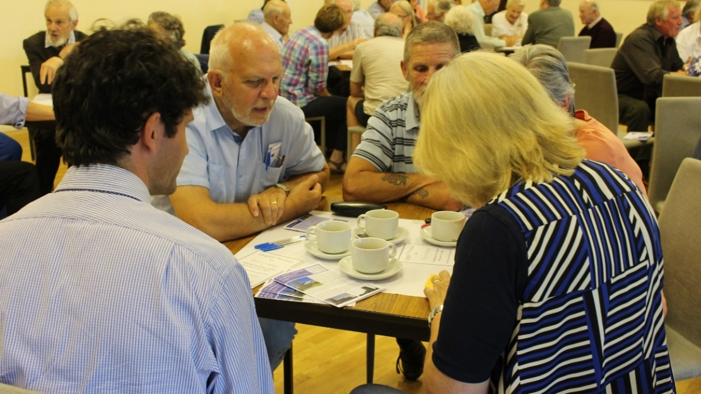
Growing the Rural Church: Mission Statement
We work with rural Mission Communities to develop their resources to enable them to grow in prayer, make new disciples and serve the people of Devon with joy.
We do this by supporting rural Mission Communities to partner with their local communities and external agencies to find sustainable missional, community, commercial or cultural uses for their church buildings, which benefit the whole community.

Slide 3
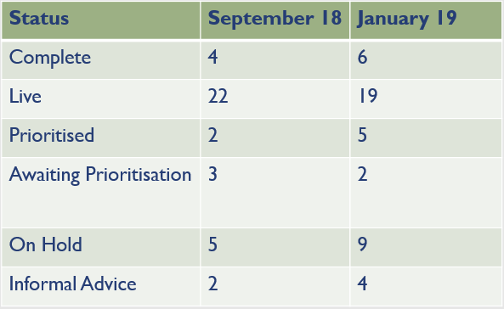
Rural Church Buildings Project Target: 100
Cumulative Target of Live and Complete to Dec 2018: 25

Slide 4
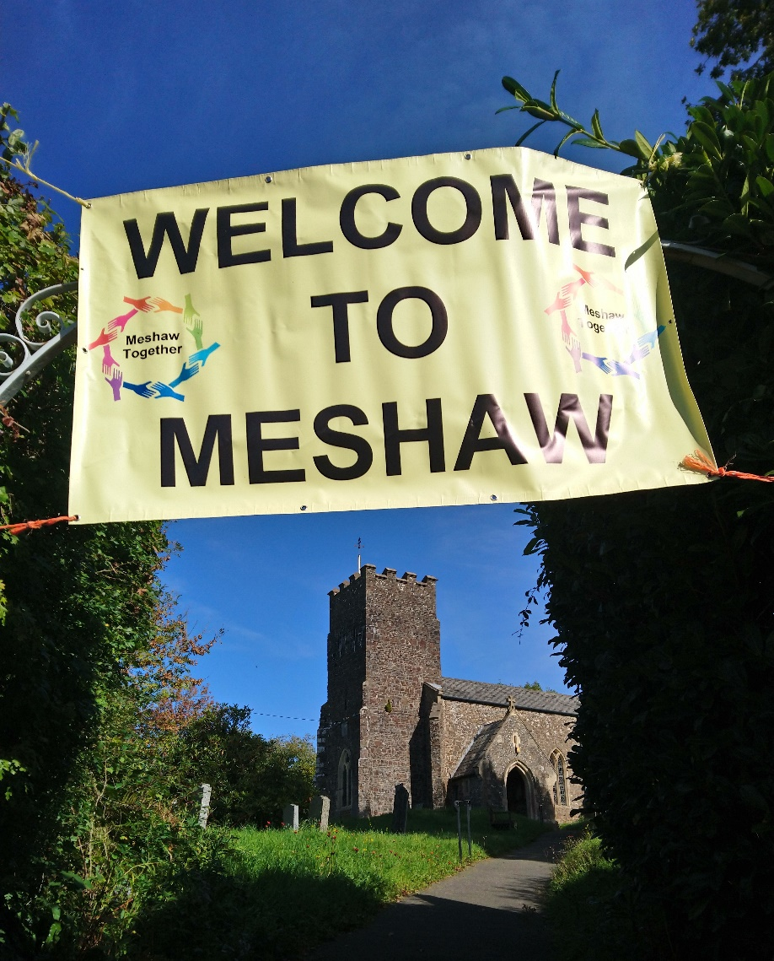
Growing the Rural Church: St John the Baptist, Meshaw
Meshaw is a small community in the Little Dart Mission Community.
The Parish Council and PCC have initiated a joint project to look at re-ordering the church as a more flexible community space.
We have partnered with Devon Communities Together to support with this and the project team have just been awarded a £10,000 grant from the Big Lottery Fund to conduct a properly resourced feasibility study.

Slide 5
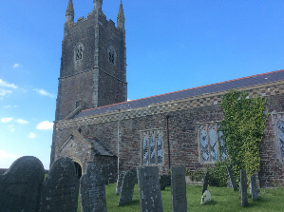
Growing the Rural Church: St James, Parkham
Develop facilities for existing activities – room to grow
Open up church for wider community use – support cafes
Exploring opportunity for hosting local library
Current activities:
Tendering for an architect
Developing feasibility plan to apply for funding to Awards for All
Consultation to date:
Stall at Village Fete - conversation and 1:1 surveys
Postal Surveys to all households

Slide 6
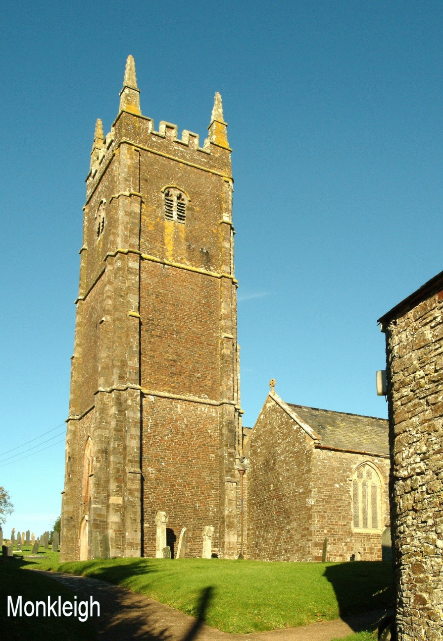
Growing the Rural Church: St George’s, Monkleigh
Initial consultation failed to raise any interest amongst the community for a wider use of the church building.
However, individuals building relationships with others at the school, on the Village Hall Committee and at the Parish Council is leading to the development of a joint stakeholder project team.
The Monkleigh project team will then plan a detailed feasibility study to explore the needs of the wider community and the fabric of all the village facilities to develop a longer term plan for the village.

Slide 7
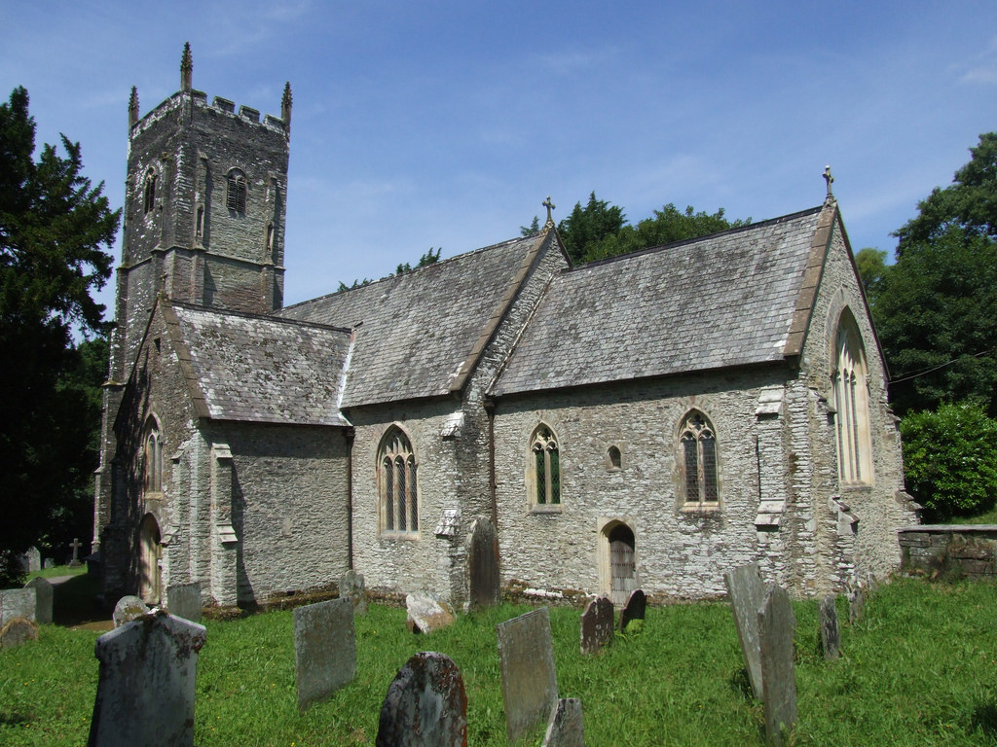
Festival Churches: St James, Arlington
Chapel of Ease in East Down with Arlington Parish
Set in the grounds of National Trust property Arlington Grange
High footfall throughout the tourist season
Working with Diocesan Worship, Prayer and Spirituality Group to develop and pilot Worship resources over this summer
Piloting digital donation unit for impact of giving figures

Slide 8
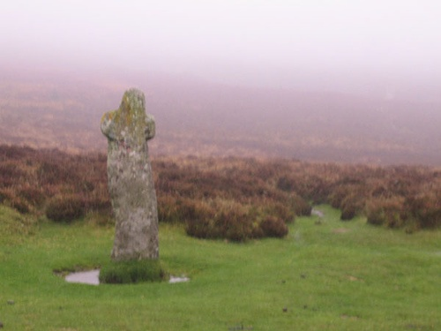
Pilgrimage: Devon Pilgrim
Two new routes:
The Archangel’s Way – Brentor to Chagford
10 churches inc. 1 Methodist Chapel
Focus on hospitality and Welcome
Opportunities for encounter
Partnerships with local businesses and artists
Launch at Dartmoor Walking Festival
One ending at the Cathedral
Route unconfirmed - St Peter’s
Cycle route
Potential launch on Ride and Stride Day
Partnership with Cathedral
Devon Pilgrim website – Information about routes, accommodation, churches (A Church Near You), local services, news and events e.g. guided pilgrimage days, contemplative worship

