Slide 1
West Dartmoor Mission Community
A 15 year overnight success
Thinking differently: various models of rural ministry
Notes:
It is impossible to capture a 15 year journey in 15 minutes. There will be much that will be left out but it is important to stress at the beginning that we are about Mission and we are about forming community. We are here as disciples of Jesus Christ to live and work for him. I know that sounds obvious but we need to hold that before us as we talk about structures and the like.

Slide 2
Crisis and Car Crash…
MoiMM 2003 – 2008 – A failure in culture to embrace change, division and lack of consensus.
Resignation and re-boot – building a brand…
The whole is greater than the sum of its parts
Consultation & Communication – “as if…”
Audit – Form follows function
Notes:
For 5 years or so after the publication of the report Moving on in Mission and Ministry we struggled to make progress. There was much talk in our parishes but this was an important time as much discussion took place as to what can be done best at what level. What can we do better together as group of parishes and what is best done locally? How can the laity limber up to take more responsibility for the life of both parish and Mission Community. These discussions were not easy and sadly in 2008 we had a crisis whereby the then Rector was so frustrated by the process that he resigned. The then Bishop of Exeter asked me to look after what then 4 parishes “only for 12 months” – and here I am 10 years later – the Self-Supporting Rector of 6 parishes and in my spare time Acting Archdeacon of Plymouth

Slide 3
2014 – a year of taking stock
We had been working “as if” we were a Mission Community since 2008, gradually developing our thinking.
We reached a stage where we wanted to consider what models of ministry were available to us.
We consulted widely
We were open and honest – there is no ‘silver bullet’ solution
The next few slides show how we approached our situation:
Notes:
To settle on 2014 in one sense is arbitrary because from 2008 to 2014 we had been working and developing a way of working without the constraints of legal structures. We wanted to see what would work for us so we worked “as if” there were legal structures in place but without them being cemented into place. We developed a constitution for our Mission Community Council. Our treasurers sat down and worked out a way of initially sharing expenses but over time other projects were funded centrally too.

Slide 4
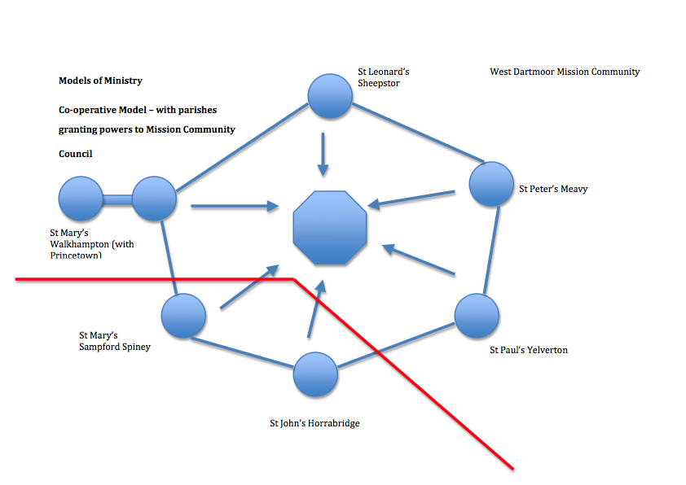
This was our set up pre-2008 working “as if” with an informal Mission Community Council
Red line denotes existing split between 2 Benefices
Notes:
By 2014 we had been joined by 2 other parishes who were also working “as if”. They had some getting up to speed to do to understand the journey we were on. This diagram shows the 2 benefices with a MCC being given powers by each PCC working “as if”. We looked at different models of how we might be most effective for mission and ministry:

Slide 5
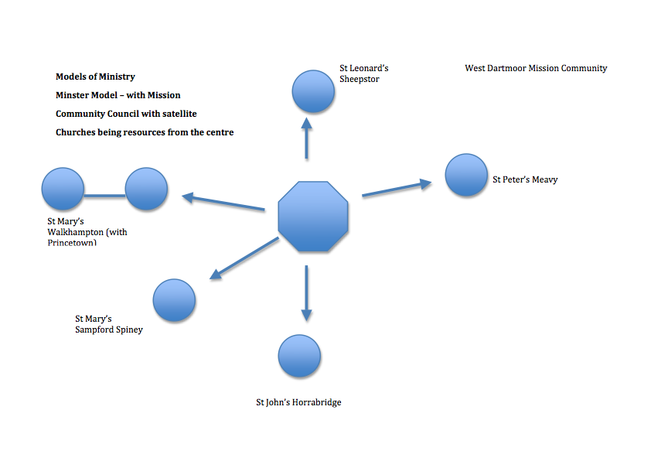
We considered a “Minster Church Model” with a central hub church and satellite churches – but this is not how we saw ourselves.
Notes:
This is a minster model which in this example places one of our parishes in the centre as a resource church. This model did not reflect how we see ourselves and was laid to one side.

Slide 6
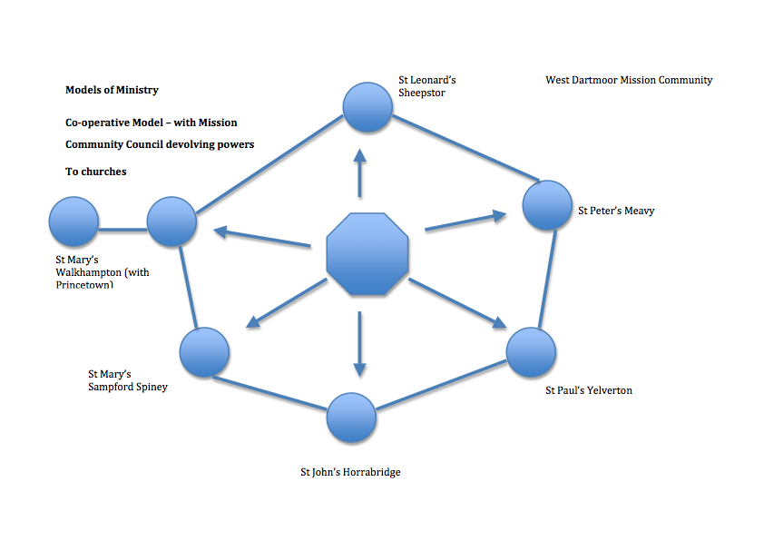
This is our current working model
Notes:
We favoured a cooperative model which better suited how we viewed ourselves. The next slides show our thinking concerning the various models we looked at:

Slide 7
Pre-2008 Structure
Strengths
People coalesce around their parish church which produces a sense of belonging
Weaknesses
Increasing pressure to find officers (churchwardens, treasurers etc retiring)
Administrative duplication
An inability to express the fullness of the Body of Christ because of lack of critical mass in any one parish
We were not one but two separate benefices and Sampford Spiney with Horrabridge were not legally members of the MCC
1.5 Stipendiary Ministers would not be able to maintain the existing pattern.
Notes:
We tried to analyse the strengths and weaknesses of each model.

Slide 8
Minster Model
Strengths
Strong Central Church – a potential powerhouse to resource outlying parishes
Parishes might or might not be retained (District Church Councils)
Weaknesses
We were not a Market Town; no one parish was in a position to be the lead church
It potentially created a 2-tier system with some churches becoming “Festival Churches” – with no idea how these would work in practice.
Could 1.5 Stipendiary Priests maintain the existing service pattern?

Slide 9
A Full Co-operative Model – still an aspiration
Strengths
All churches have equal weight and say
We would be one united Benefice
A central MCC for administration and policy decision making
Individual Churches look after their buildings via District Church Councils with restricted funds to do so.
The number of Legal Officers is reduced [deputies are appointed at DCC level]
Pooling of Resources
Weaknesses
Potentially a lack of co-operation and sense of belonging to a larger grouping
It might prove difficult to recruit people to take on a larger legal role as Wardens
Practical tasks still needed to done at DCC level
Notes:
This is the model we are still working towards as DCCs can only become a reality if we become a single parish.

Slide 10
Where are we now in 2018?
We are a United Benefice of 6 Parishes [Rule 19 CRR 2017]
We are still on a journey… But are ‘resting awhile’…
Looking to the future we will consider becoming one parish.
Mission Community Council controls MAP and is reviewed annually at an away day. Mission aims are set centrally as is the service pattern & dovetailed into Diocesan Strategy – Pray, grow, serve with joy.
PCCs deal with delegated matters – buildings etc

Slide 11
Do not fear failure
After School Service
10.15 Midweek Communion Service
Trainee Youth Work project evaporated after 1 year
Stop things that do not work
Notes:
We tried an informal after school service – we thought parents would drop in after school with children – they simply drove past…
Our 10.15 Midweek Service number s collapsed so we stopped it
We partnered with another local charity and had a trainee youth worker with us in the Benefice for 12 months but the project faltered when our partner organisation could not find a replacement to carry on the work

Slide 12
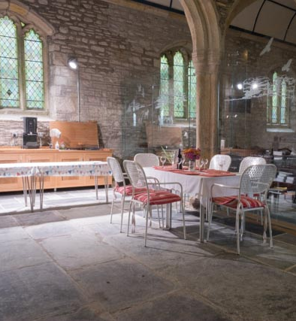
Celebrating Success part 1
Thursday Evening Service
Social Media & Website – (much praised)
Partnering with others – Plymouth University, Growing the Rural Church Project, Churches Conservation Trust, Dartmoor National Park,
Identify the USP of each church – mission to visitors & walkers (Sheepstor); Champing (St Mary’s Walkhampton); Concert venue (St Paul’s); Chocolate box weddings (St Peter’s); Tranquillity (St Mary’s Sampford Spiney); Social engagement (St John’s). – Unity does not mean uniformity.
Notes:
There are real questions about how you can measure ’success’ – is it ‘bums on seats’? Paying the Common Fund? Having successful structures? Is it pointing to ‘pray, grow, serve’? It is always hard to measure qualitative matters as opposed to quantative matters!

Slide 13
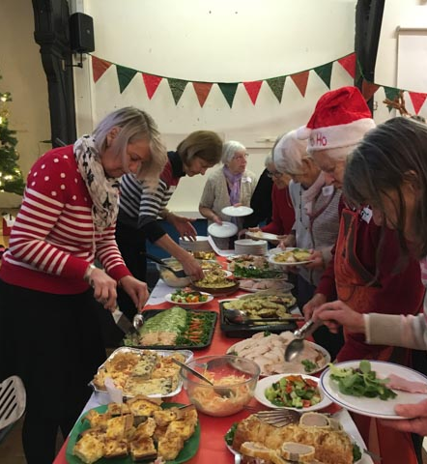
Celebrating Success part 2…
“Poppins” – Parent & Toddler Group
Nosh@9.30 – all age service
Benefice Choir – drawn from all parishes
Parish based Worship Teams leading a monthly service of the Word in 5 out of 6 parishes
Themed Supper Evenings
Men’s breakfasts
Ladies’ Lunch

Slide 14
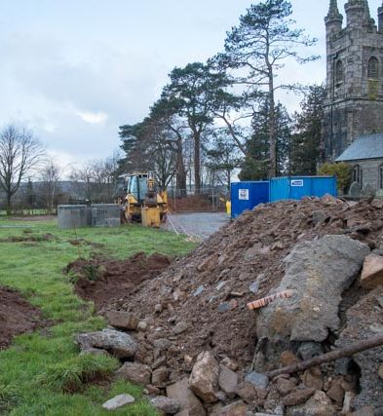
Celebrating Success part 3…
All our buildings have undergone improvement works and some major re-ordering work
Home Groups – 3 across the Mission Community – one meets weekly, 2 monthly.
Vocations – new Reader
A part-time administrator to deal with safeguarding, comms, database (Church Support Hub), etc and Mission Community Office
Positive engagement at Mission Community Meetings

Slide 15
With an eye to the future we have concerns
Some parishes are finding it difficult to fill church officer posts – churchwardens, treasurer and secretary
Financial burdens are increasing while committed givers are diminishing
The age profile of congregations is a concern
We are still struggling to engage with children and youth
These factors are unsurprising and will drive further change….

Slide 16
At the end of the day, it’s God’s Church…
1 Thessalonians 5:24
The one who calls you is faithful, and he will do this.

