Slide 1
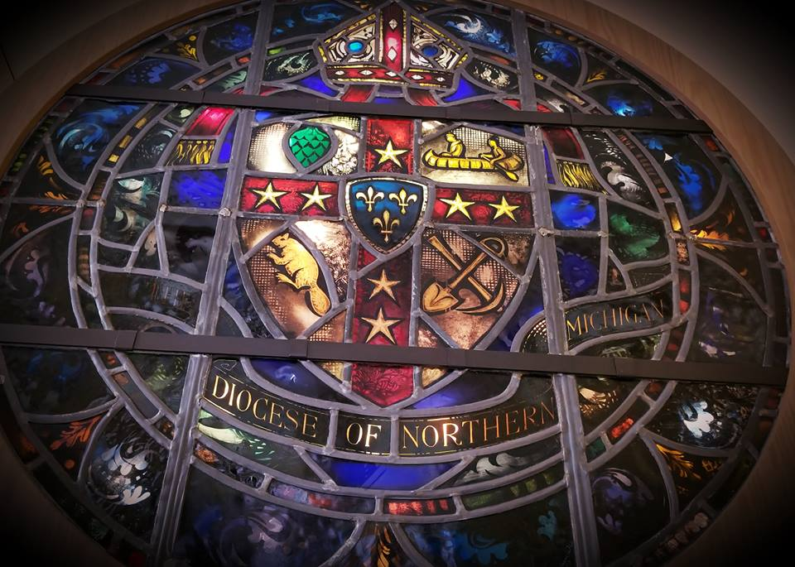
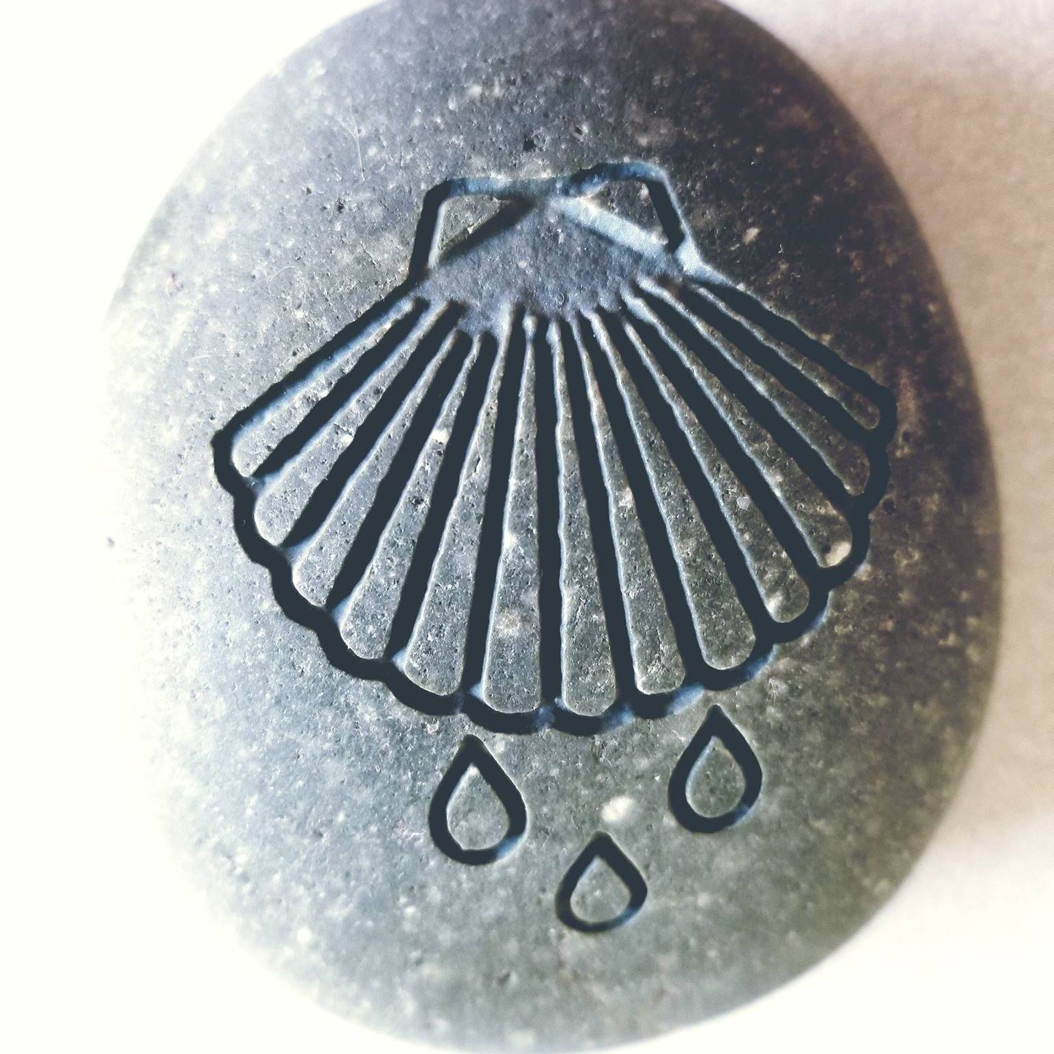
Mutual Ministry as developed by the Episcopal Diocese of Northern Michigan

Slide 2
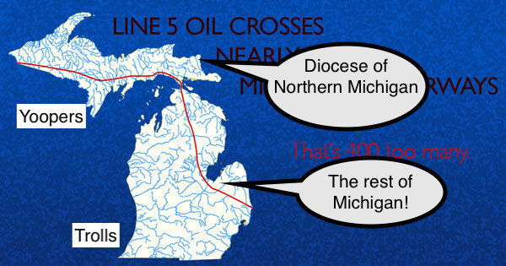
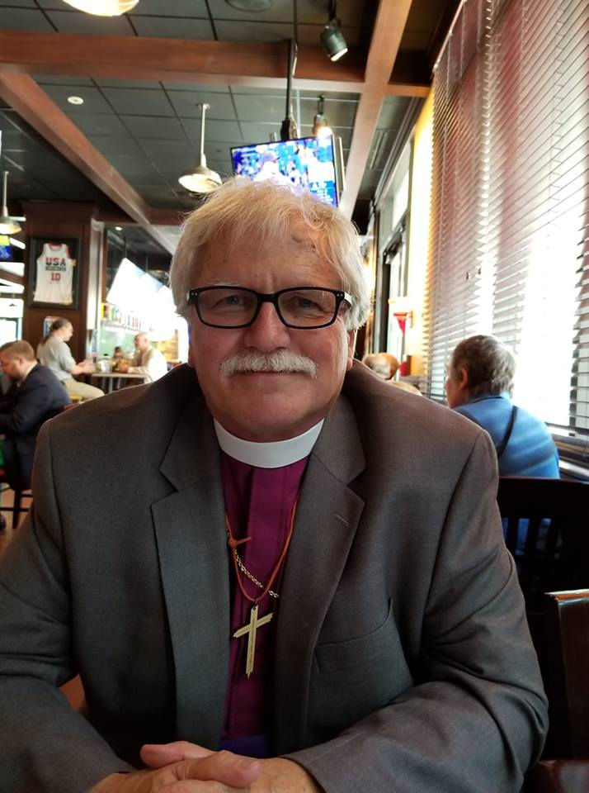
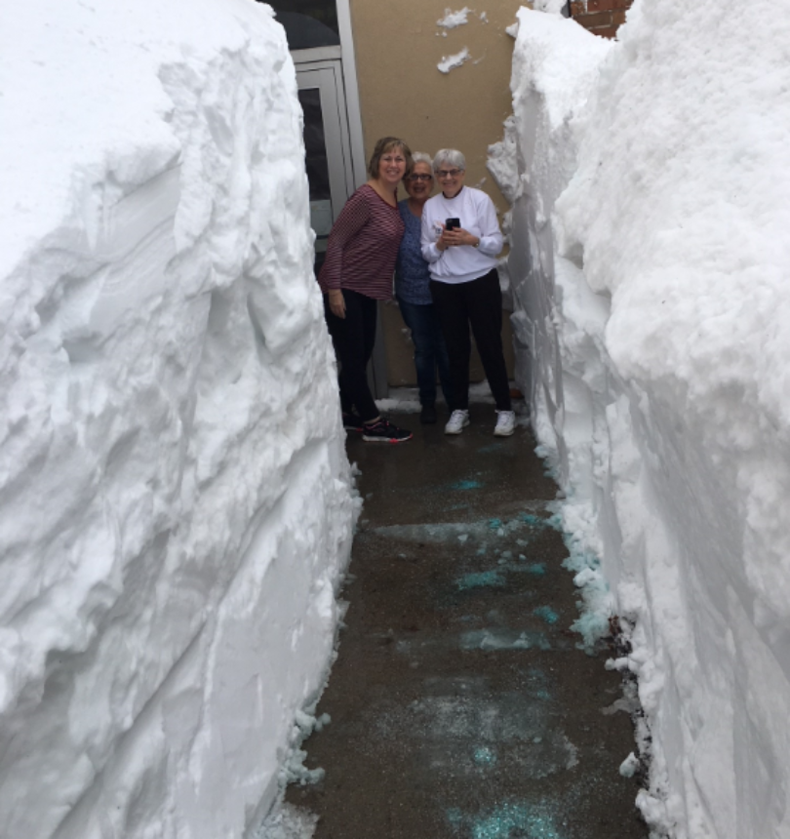
The Rt Revd Rayford Ray
11th bishop of the diocese
16,377 square miles
population: 311,361
32 Episcopal Churches
(the size of many of our own
deaneries..keep that in mind!)
Divided into 3 mission groups
With 3 stipendiary Mission Developers

Slide 3
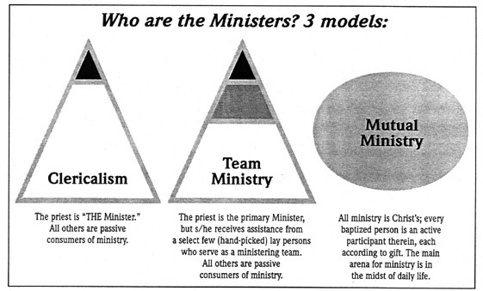
“The main arena …is in the midst of daily life.”
Rural folks get this by nature…how do we help them
see it as ministry?
“every baptised person is an active participant…”.
A thought: how do we then invite the unbaptised?

Slide 4
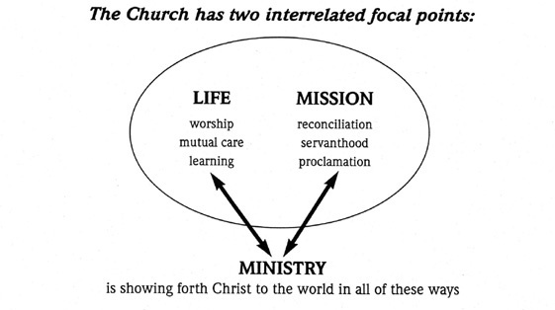
Our Goal is to transform our congregations from being communities
gathered around a minister to MINISTERING COMMUNITIES.
Our Strategy is Mutual Ministry Development. NOT clerical ministry delivery and NOT team ministry delivery
Our Tactics
(1) clustering through our regions
(2) developing local ministry

Slide 5
How it works (VERY basically)
PCC of congregation/s interested in mutual ministry process meet with bishop.
Bishop or rep. meets with whole congregation
If they want to proceed: consultant is appointed, 4 meetings with PCC and/or other leadership folks…..identification of individuals for possible needed ministries.
4. Education: Those people invited to form Covenant Group that will meet twice
month for 3-4 hr sessions using the diocesan curriculum (at a location within that
team and any in congregation also welcome to attend these meetings)
5. Evaluation (on-going) Upon completion of curriculum, the Covenant Group is
examined by diocesan Commission on Ministry.
6. After all necessary diocesan approval—Ordination/licensing follows.
Ministries:
Diaconal—both deacons (ordained) and diaconal coordinator
Apostolic— stewardship, educational, and ecumenical coordinators
Priestly—Priests (ordained) and Preachers (licensed), coordinators
Regional Missioners: Providing consulting, supervising, and mentoring services to
congregations and regions as mutually agreed to by Bishop's Committees, Vestries,
Regional Boards, Bishop, Council, and themselves.

Slide 6
