Slide 1
Growing the Rural Church Presentation for Education Team November 2017

Slide 2
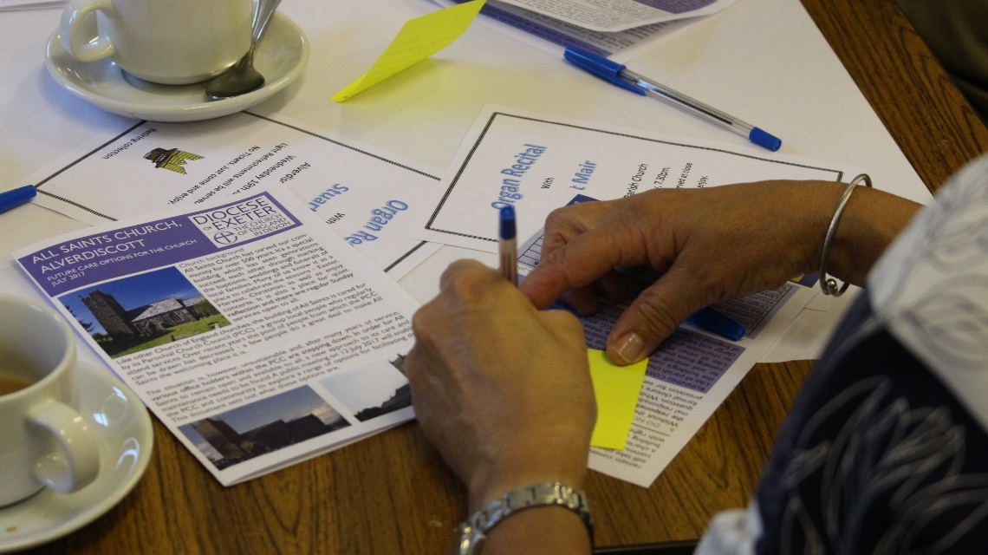
Growing the Rural Church: Mission Statement
Growing the Rural Church works with rural Mission Communities to develop their resources to enable them to grow in prayer, make new disciples and serve the people of Devon with joy.
We do this by supporting rural Mission Communities to partner with their local communities and external agencies to find sustainable missional, community, commercial or cultural uses for their church buildings, which benefit the whole community.
When we do this, we ensure that
the public spaces offered by our
rural church buildings, both for
worship and extended missional,
community, commercial or cultural
use, are sustainably managed and
remain open and available.
Relationships between our rural
churches and their local communities are strengthened, and more people are drawn into the life of our rural Mission Communities.
Notes:
7 years
1.8 million in funding

Slide 3
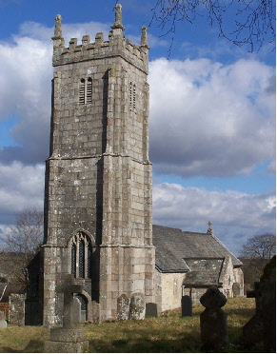
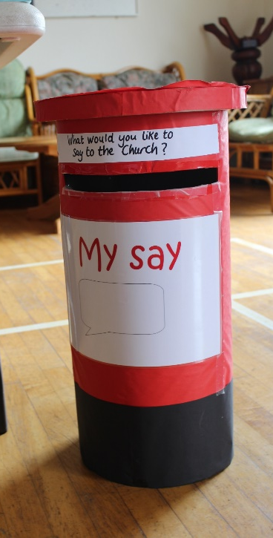
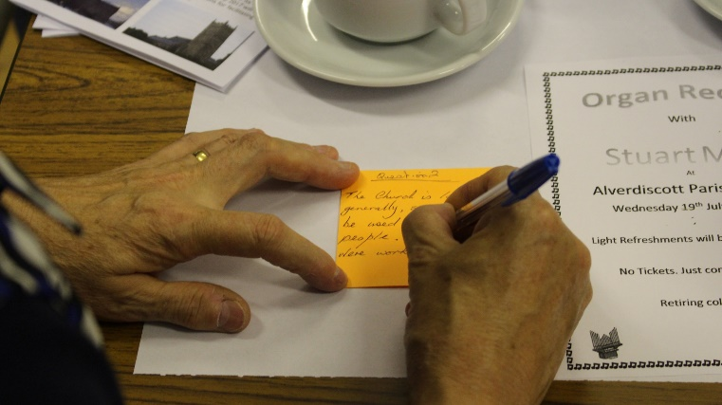
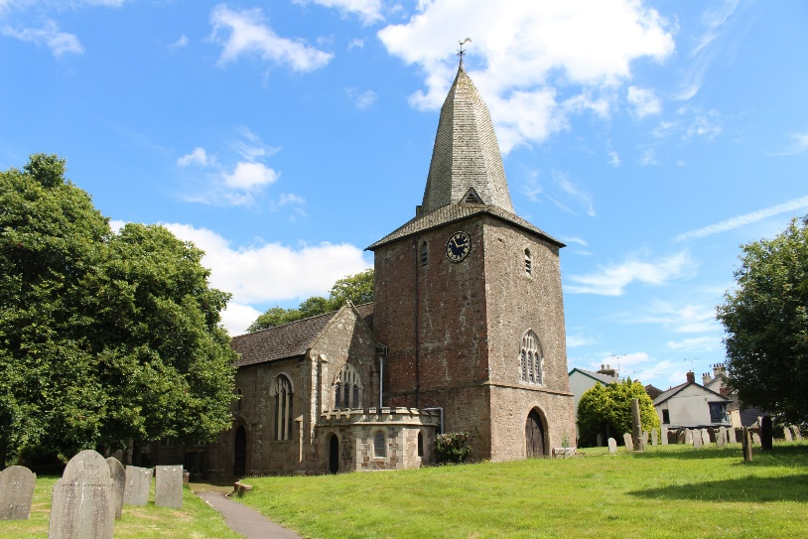
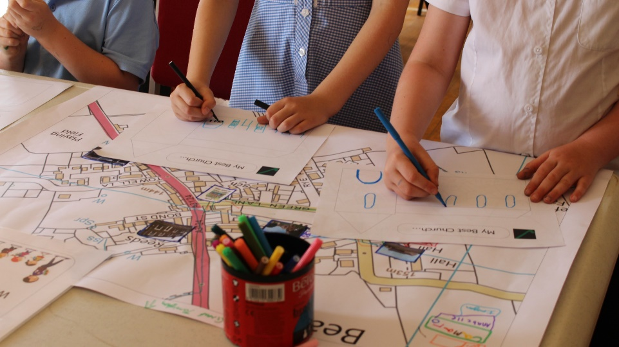
Growing the Rural Church: Pilot Projects
To develop models of best practice and
to inform the project’s future progress
we are running a number of pilots

Slide 4
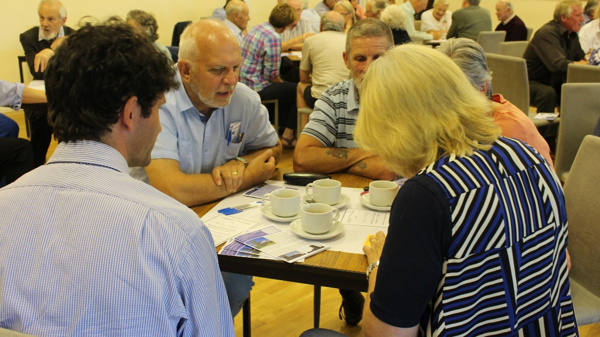
Growing the Rural Church: Pilot Case Study
Two Rivers Mission Community is made up of 11 churches in rural north Devon, served by two clergy Revd. Mike Clark and Revd. Paul Bysouth
Identified 4 churches: Alverdiscott, Beaford, Huntshaw and Yarnscombe.
Alverdiscott: public meeting in July may lead to development of Friends Group or Community Trust
Beaford: consultation focused on
community needs at events in July
and September
Huntshaw: exploring development of
a Friends Group
Yarnscombe: set up new special
committee of PCC

Slide 5
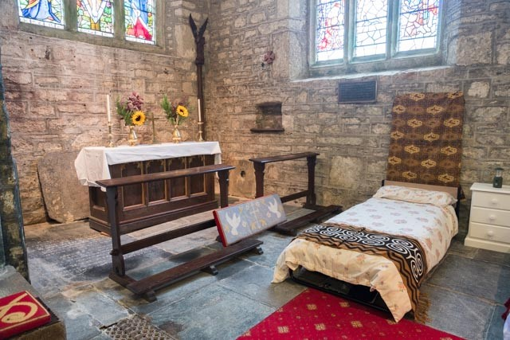
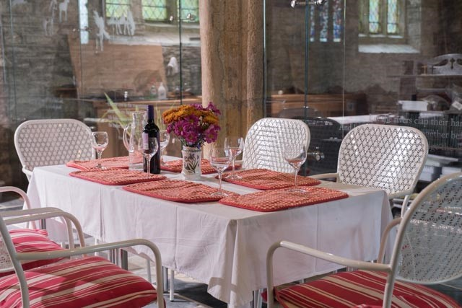
Growing the Rural Church: Pilot Case Study
The Churches Conservation Trust have the developed the concept of Champing™ (church camping) in their
Churches over recent years. Now, they are beginning to partner with open churches and one of the first of these will be St Mary’s Walkhampton on the edge of Dartmoor.
Between March and September 2018, up to 4 guests will be able to stay in the church. Bookings will be handled by the Champing Team, but meals and housekeeping will be provided locally, adding a small boost to the local economy.
There has been another positive outcome through consulting with the community on the Champing project. In recent years, due to security concerns, the church has been kept locked. However, the PCC and community are now looking at ways to have the church open in the daytime, so more people can enjoy the space.

Slide 6
Growing the Rural Church: Partnerships
We are developing a number of partnerships to support aspects of the project’s work:
Devon Communities Together – experience in community consultations
The Churches Conservation Trust – experience in creative uses of church buildings
Mosaic Creative – deliver a creative, bible based course for churches exploring their mission and service to communities.
Stir to Action – South West based organisation which supports creating sustainable community enterprises

Slide 7
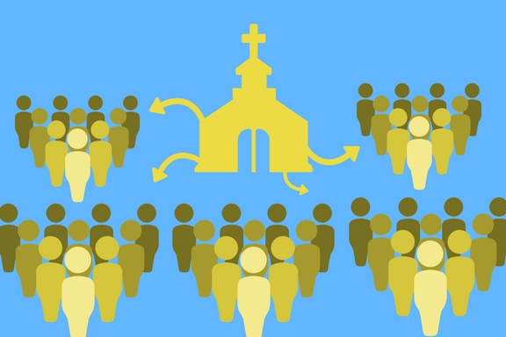
GtRC Outputs 2017
GtRC currently has 8 live projects….
Which means:
We are engaging with 53 churches across 8 Mission Communities on issues including discipleship, mission, governance and church buildings.
We have engaged more than 400 young people and adults in community consultations.
And we are working with 9 specific churches on sustainability.

Slide 8
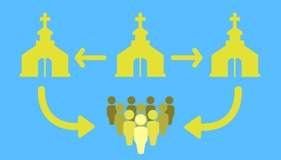
With the result that…
1 church is developing Champing™
1 church is developing shared governance
2 churches are developing social enterprises with their local communities
3 churches are developing Friends Groups initiatives
3 Mission Communities are reviewing their approaches to mission and ministry
…and many more are on their learning journey

