Slide 1
Changing Food Cultures:
Challenges and Opportunities for UK Agriculture
Professor Michael Winter OBE
University of Exeter & Board Member for Natural England, UK Joint Nature Conservation Committee and Rothamsted Research.

Slide 2



Background to the Report
30th June 2016 From Mike Vacher, Director of the Nuffield Scholarships Trust inviting me to apply.
‘How does the UK Farmer deliver to the
UK Food Culture(s) of the 2030s.’
Denmark and Canada
Moving out of my intellectual comfort zone: from farming to food and from food to health
<a href="https://clipartxtras.com/">clipartxtras.com</a>

Slide 3
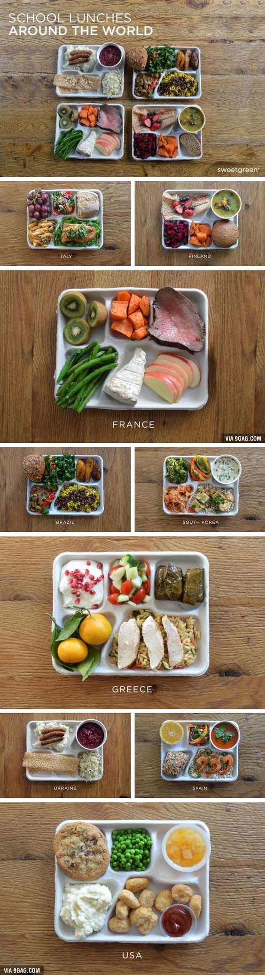
So What is Food Culture?
The what, where and how of our daily sustenance.
The social context and relationships in which eating take place.
The meaning and significance we attach to food.
Links across to gender, identity, aesthetics, ethics, spirituality, ceremony, …. it varies across time and geography.

Slide 4
In the report I have structured my exploration of food culture like this:
Availability - the manner in which food is provided and made available through production and manufacturing.
Acquisition - the manner in which food is obtained through shopping, household budgeting and cooking.
Appropriation - the manner in which food is consumed.
Anxiety - the manner in which food contributes to worries about health and ethical concerns about the food system.
Draws on work of eminent food sociologist Alan Warde.

Slide 5

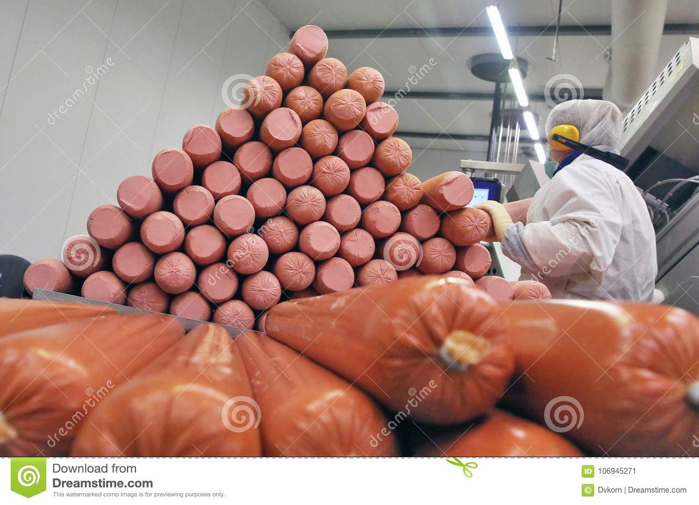

Availability
The dependence on global trade.
The role of manufacture and processing.
The role of finance capital.

Slide 6
Total World Exports – Selected Crops (thousand tonnes), 1961-2013
Sample Text
food culture, human health, agricultural production,

Slide 7
Sample Title One
World Exports as a Percentage of Total World Production – Selected Crops and Livestock, 1961-2013
Sample Text
food culture, human health, agricultural production, health policy and agricultural policy I am engaging with very substantial areas of academic endeavour. More sample text
  And a bit more
  And a bit more
    And even more, if you have this many indents

Slide 8
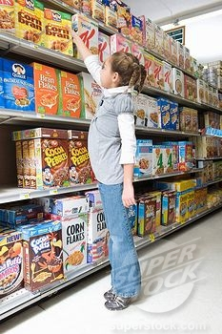
Global Food - more diversity or less? c
Of the 7,000 plant species documented as human food just three – rice, wheat and maize – provide half the world’s plant-derived energy measured in calories.
Breakfast – for all the appearance of choice that the large number of mainstream processed cereal brands offer, most are based on one of the three big crops - wheat, rice or maize - with plenty of sugar as well. Therefore they are inherently linked to global commodity trade and the choice of brands belies the underlying sameness of the dietary offer.

Slide 9
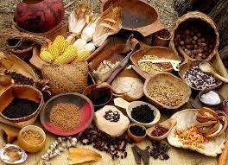
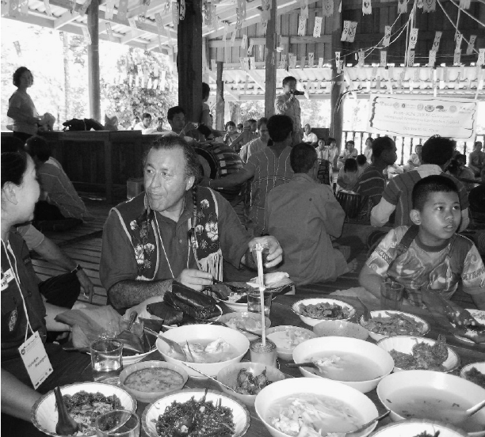
BC First Nations Traditional Diet
“Seafood, particularly salmon …oolichan, sturgeon, herring, trout, and cod …. Clams, mussels, cockles, crabs, and urchins. … seals, porpoises, and whales … grouse and ducks. Over 200 species of plants … roots, bulbs, tubers, stems, shoots, buds, leaves, and fruits all provided essential nutrients. Some groups also consumed seeds, nuts, and the inner bark of certain trees. …. among coastal groups alone, wild plants used for food include about fifty species of berries … twenty-five species of green vegetables, … several species of marine algae.. and about fifty (other) species of plants.”

Slide 10
Sample Title One

Slide 11
Acquisition
In 1950, independent grocers accounted for 78% of UK grocery sales, but by 1984 their market share had tumbled to below 30% and by 2015 to less than 10%.
The growth in market share by the multiple food retailers increased from 23% in 1950 to 57% in 1990 and to 93% in 2015.
But more change is taking place - online sales accounted for 7.3% of the UK grocery share in 2016 (second only to South Korea in terms of the proportion of groceries bought online).

Slide 12

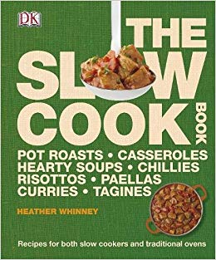


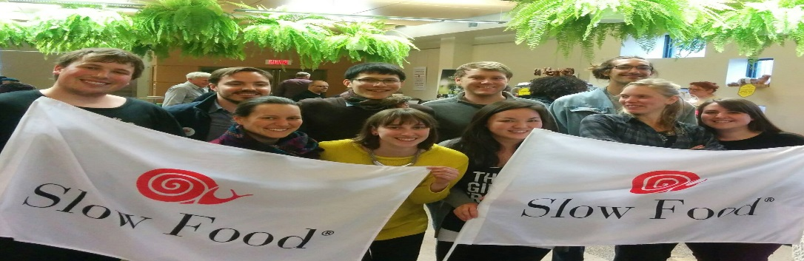
Appropriation
In 2016 more food and drink books were sold than ever before. 8.7 million books, with a value of £90.3 million.
“Gastronomy is the intelligent knowledge of whatever concerns … nourishment. …. It enables us to experience educated pleasure and to learn pleasure loving knowledge. …. gastronomy is culture, both material and immaterial. Choice is a human right: gastronomy is freedom of choice. Pleasure is everybody’s right and as such must be as responsible as possible: gastronomy is a creative matter, not a destructive one. Knowledge is everybody’s right, but also a duty; gastronomy is education.” (Petrini 2007: 55)

Slide 13
Anxieties
(drawing on Alan Warde again)
Physical concern about the hazards that may be associated with modern, particularly processed or ‘de-natured’ foods.
Social and moral concern that the changes in eating habits and practices are adversely affecting family life and social mores.
Symbolic concern that the demise of a traditional menu and a troubling excess of choice symbolises consumer confusion, even identity crisis.
Economic concern about the power of retailers and value for money.
Ethico-political concern about animal welfare, the natural environment, the implication of trade for poorer countries, etc.
To this I would add an additional concern for provenance with issues of localism and national identity cutting across the other concerns.

Slide 14
And so we turn to Health

Slide 15
Global Burden of Disease (GBD) study
(Newton et al 2015)
In the UK, dietary risks are the leading cause of lost Disability-Adjusted Life Years (DALYs) which quantify both premature mortality and disability within a population.
The largest contributor to DALYs are dietary risks related to low consumption of fruit, vegetables, whole-grains, nuts, seeds, seafood omega-3 fatty acids and milk and high consumption of red meat, processed meat, sugar-sweetened beverages, and low fibre.

Slide 16
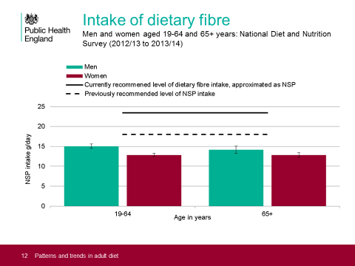

Slide 17
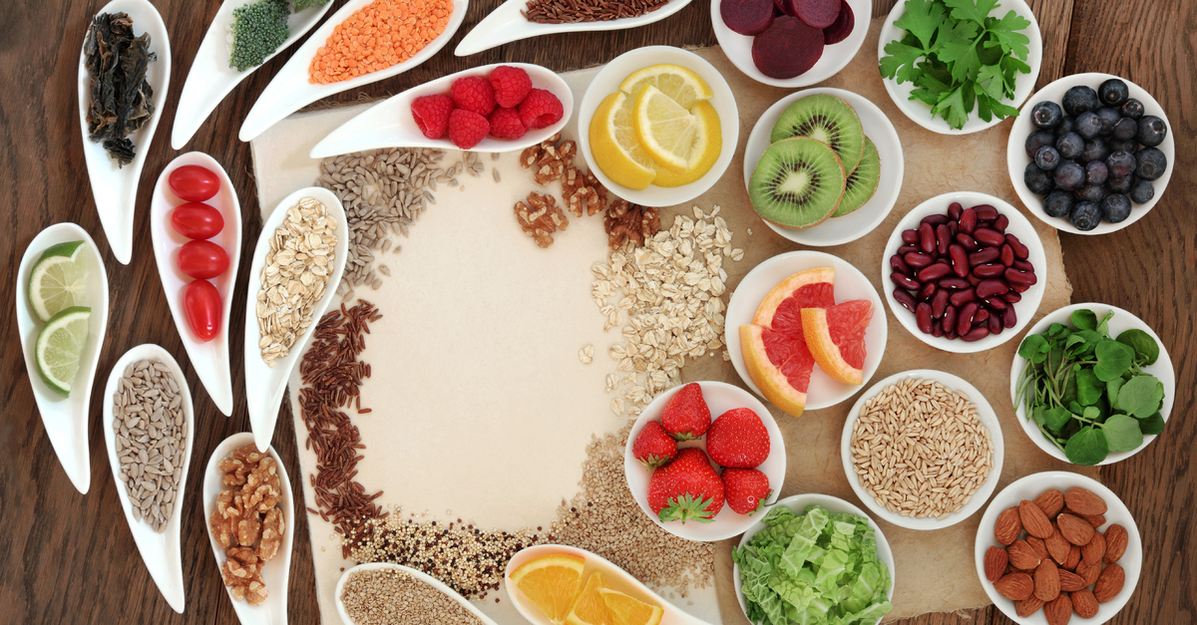
Which brings us to agriculture
Fibre comes from:
Wholegrain breakfast cereals, wholewheat pasta, wholegrain bread and oats, barley and rye.
Fruit such as berries, pears, melon and oranges.
Vegetables such as broccoli, carrots and sweetcorn.
Peas, beans and pulses.
Nuts and seeds.
Potatoes with skin.

Slide 18
Trade in Fruit and Vegetables, UK (£ million at 2016 prices)

Slide 19
Diversifying the Cereal Sector
Biskup et al (2017) found that spelt
and rye induced a lower acute
glycemic response (increase in blood
glucose levels) compared to refined
wheat, providing strong evidence that
spelt might play an important role in
the prevention or delay of diabetes
development.

Slide 20
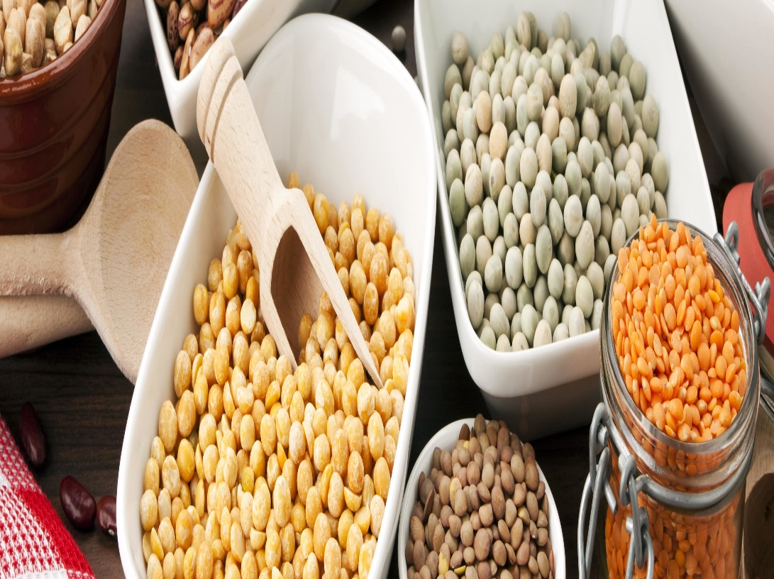
UN International Year of Pulses 2016
In the period since 1961, whilst global cereal yields increased from 1,450 to 3,900 kg/ha, pulse yields only grew from 550 to 1,000 kg/ha. In the UK pulses account for less than 2% of total protein consumption,
The IYP certainly had an impact in some parts of the world, for example 1,257 new pulse-containing products were launched in North America in 2016.
The ‘Eating for Energy’ base in Vancouver,
Canada was one of the responses to the IYP
with its Just Add Pulses campaign.

Slide 21
Recommendations:
POLICY DEVELOPMENT
There is a need to develop a food and farming strategy for the delivery of safe, nutritious and affordable food in the UK, which will allow UK farmers to respond with confidence to the concerns and opportunities presented by civil and consumer society.
There is a clear policy imperative to support farmers through the transition to post-Brexit agriculture and policy needs to be designed to ensure that a strong, competitive and food health-oriented industry emerges.
Agricultural policy should be more focused on health and nutrition.
Nutritional security should be seen as a ‘public good’.

Slide 22
Recommendations:
POLICY DEVELOPMENT
Sustainable Intensification policy and research should be broadened to include human nutrition as a core element.
A new conversion and/or grant scheme should be developed for horticulture.
There should be policy encouragement for the cultivation and market development of pulses.

Slide 23
Recommendations:
INNOVATIVE AND DYNAMIC MARKET STRUCTURES
Quality Assurance Schemes should be deepened to include nutritional quality at the core.
There is a need to develop stronger and shorter supply chains focused on nutritional qualities of food.
The lessons of the food sovereignty movement need to be considered to see whether a UK version is possible

Slide 24
Recommendations:
ENHANCING SKILLS AND DEVELOPING
COMMUNITIES OF PRACTICE
There is a need to facilitate new entrants into agriculture and to up-skill existing farmers, especially smaller farmers.
An up-scaling or expansion of the Prince’s Countryside Fund Farm Resilience Programme would be particularly welcome in this respect.
Further development is needed of new communities of practice around food provisioning.

